Slide 1
RISK
Based on “10 Ways We Get The Odds Wrong”
By Maia Szalavitz

Slide 2
Background: Emotion vs. Thinking
The Past Was a Dangerous Place:
Dangerous predators
Food uncertainty
Other humans most likely a threat
No science, no technology, and no education to help
Weakness of conscious, rational attempts to assess danger:
far too slow
often provide multiple answers, each somewhat probable
not sufficiently motivating

Slide 3
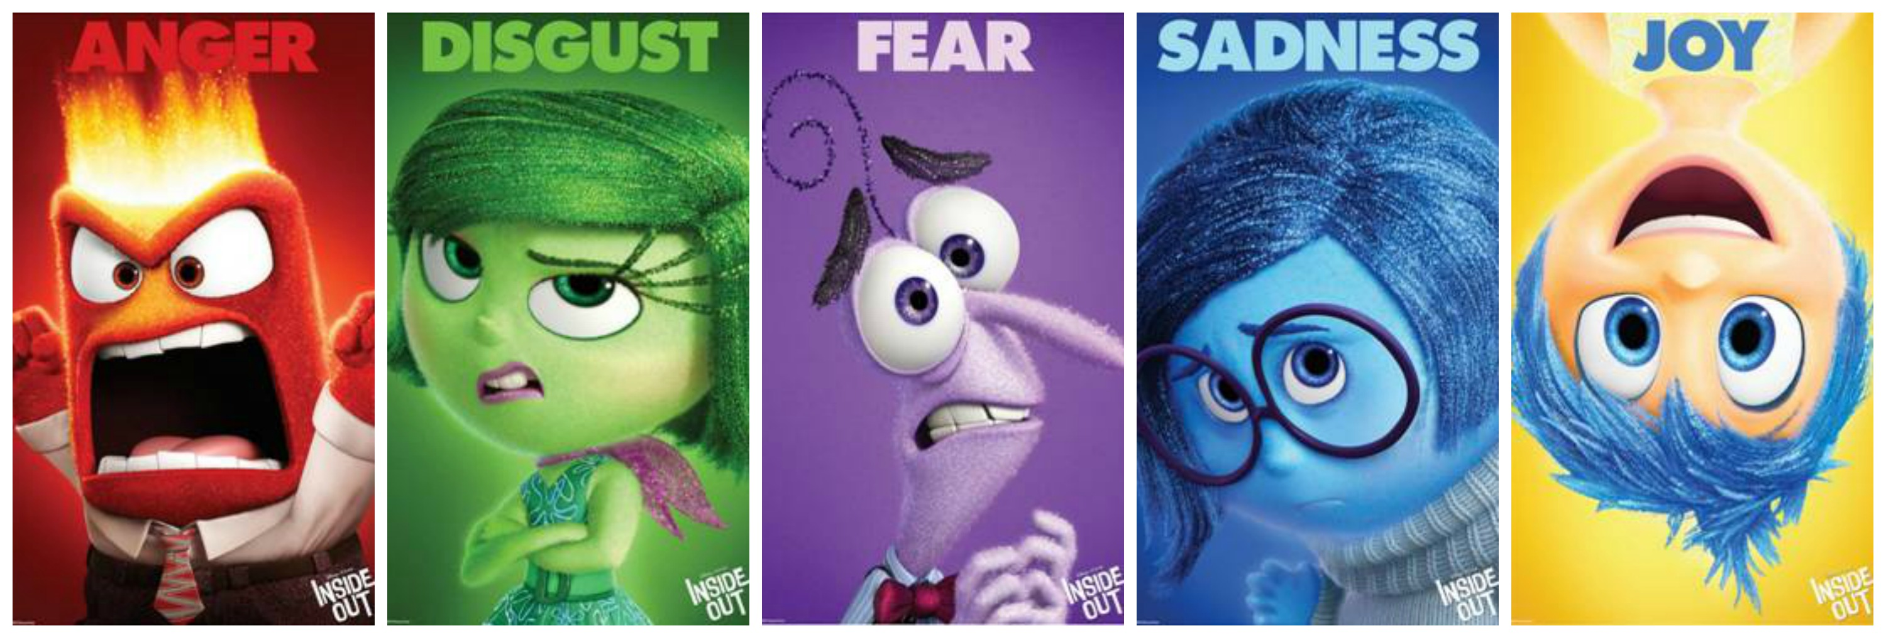
Background: Emotion vs. Thinking
The Benefits of Emotions:
Lightning fast
Provides clear direction for how to act
Highly motivating

Slide 4
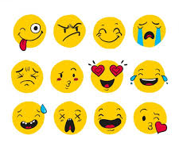
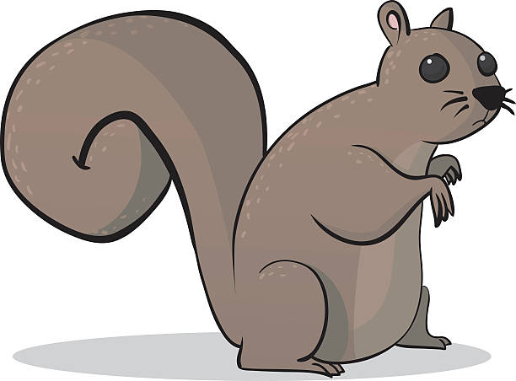
Background: Emotion vs. Thinking
“Emotions are decision-making shortcuts”
In an age before science, technology, and education, it made sense for evolution to have us assess risk through feelings of fear or excited anticipation, rather than letting us just “think matters over”
What we lost in precision,
We more than gained in speed and motivation
This is how all mammals do it

Slide 5
Problems with the Risk-Assessing System Evolution Gave Us
We have changed our Lived Environment enormously:
Each new technology creates new types of risk, while eliminating previous ones
We have also in those years invented capitalism, and the advertising industry that comes with it, as well as democratic politicians who need to attract our votes
Powerful groups devoted to making us misperceive where there are and aren’t risks

Slide 6
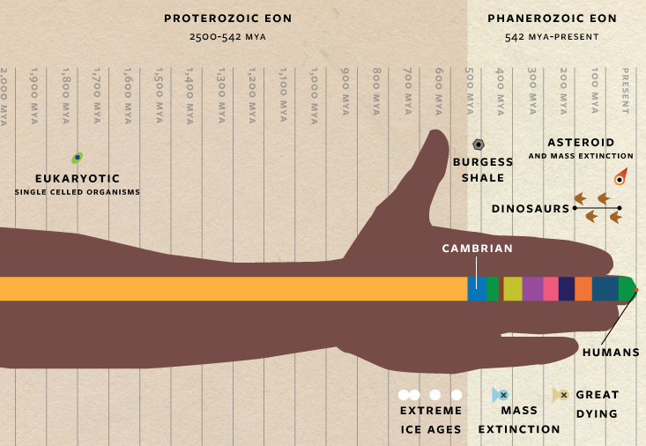
Problems with the Risk-Assessing System Evolution Gave Us
Evolution is very slow
We will only change our brain’s “operating system” gradually, over tens of thousands of years
And only if the people who have slightly different ways of feeling risk die before reproducing
We are still running brain software optimized for the world of 50 000 years ago, while trying to navigate the modern world
We therefore overestimate some types of risk, and don’t see others

Slide 7
OUR AGENDA FOR THE REST OF CLASS:
Examine Five Different Biases that Effect how we perceive risk
The first three are all well-explained by the evolutionary perspective we just examined
These are the kinds of mistakes that we should expect, given that our brains are adapted to a world very different from our modern world
The fourth biases doesn’t appear to have anything to do with evolution...
Though maybe I’m just missing the connection, and you can point it out to me!
The fifth, final bias is a real mystery, since it seems to be exactly the opposite of the kind of bias we might expect would arise from our evolutionary history
Where did it come from?

Slide 8
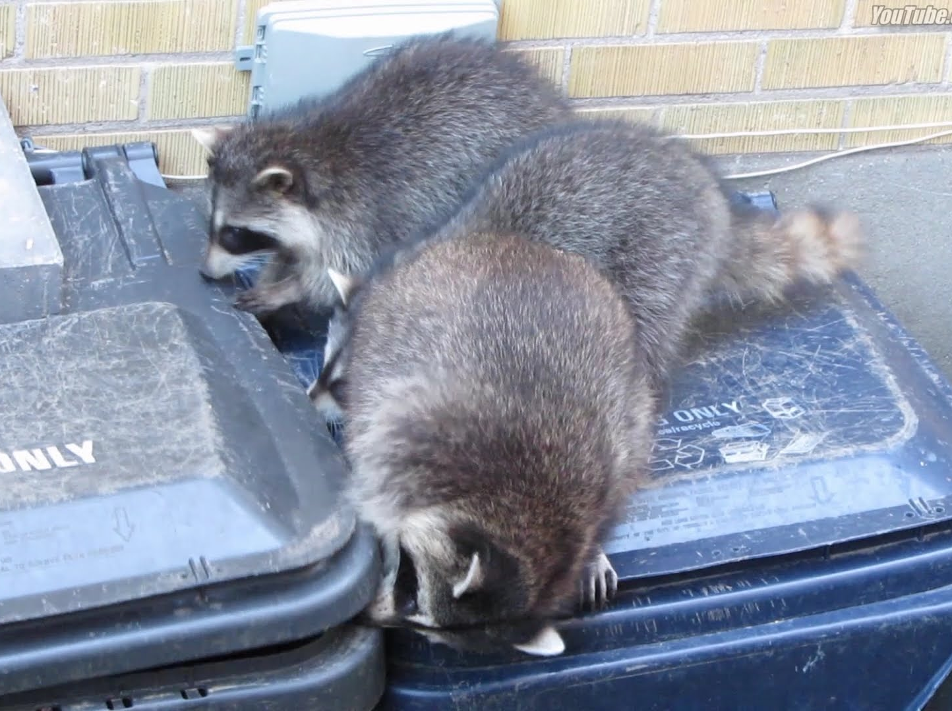
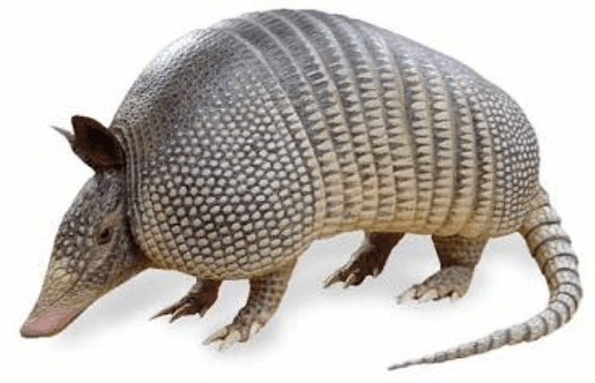
1) The “Availability Heuristic”
"Heuristic” = a short-cut in thinking that saves a lot of time and usually gives us the right answer, though not always
The availability heuristic: the brain’s unconscious assumption that things are more common if they are easy to recall
Are there more racoons or armadillos in Toronto?

Slide 9
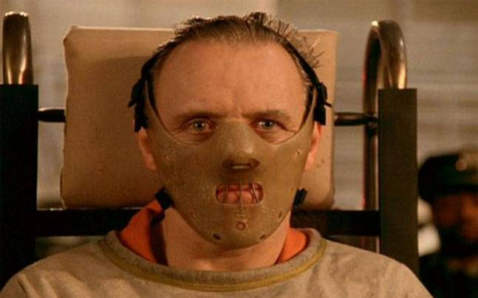
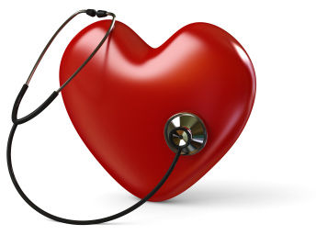
1) The “Availability Heuristic”
PROBLEM: Scary things are much easier to remember
and so we overestimate how common they are
There are not really very many serial killers in the world…
But they sure are memorable!
Stories about routine heart disease and traffic accidents are far less memorable
Though far deadlier

Slide 10
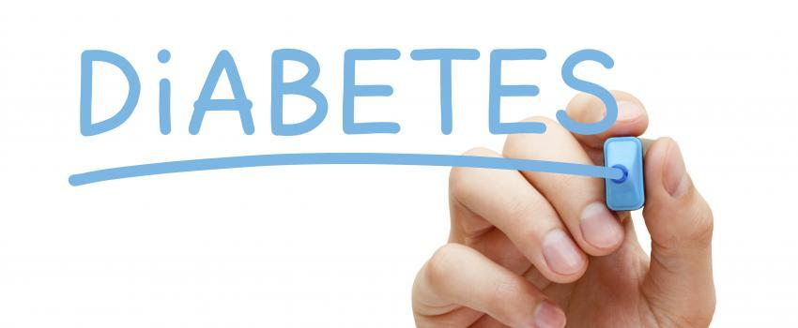
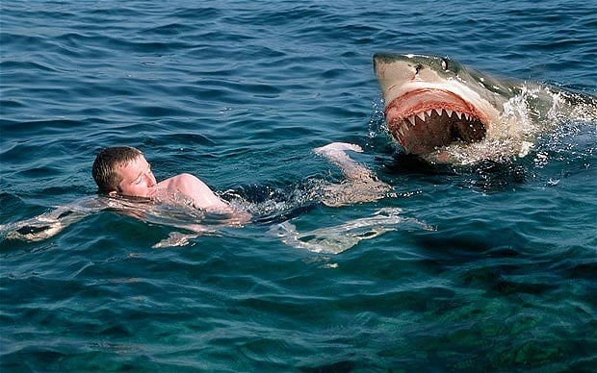
1) The “Availability Heuristic”
Our modern media environment is heavily biased towards the shocking, fearful, and rare
“if it Bleeds, It Leads”
Are you more likely to share a story about a shark attack or death by diabetes?

Slide 11
1) The “Availability Heuristic”
CONSEQUENCES:
We misunderstand where the real risks lie
After the September 11, 2001 attacks, Americans watched video of the two hijacked planes crashing into the Twin Towers over and over again
This made the worst outcome of flying highly memorable, and thus seem more likely
Many people therefore changed their holiday plans that year, driving rather than flying
Since driving is actually much more dangerous than flying, about 1000 more people died that year in traffic accidents than otherwise would have

Slide 12
2) Insensitivity to Gradual, Long-Term Risk
In the world where we evolved, lifespans were much shorter than now
Minor Injuries were often fatal
Diseases easily treated today were fatal
Childbirth was extremely risky for both child and mother
Famine was common
Strangers were presumed dangerous
Living to 50 made you old. Living past 2 already required some good luck
When there might not be a “long-term,” it made sense to ignore long-term risks and focus instead on the here and now

Slide 13
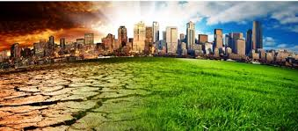
2) Insensitivity to Gradual, Long-Term Risk
It is still very hard for us to “feel” that distant risks are a big deal, even when their consequences could be catastrophic
Example: Climate Change
Split between what we “know” and what we “feel”

Slide 14
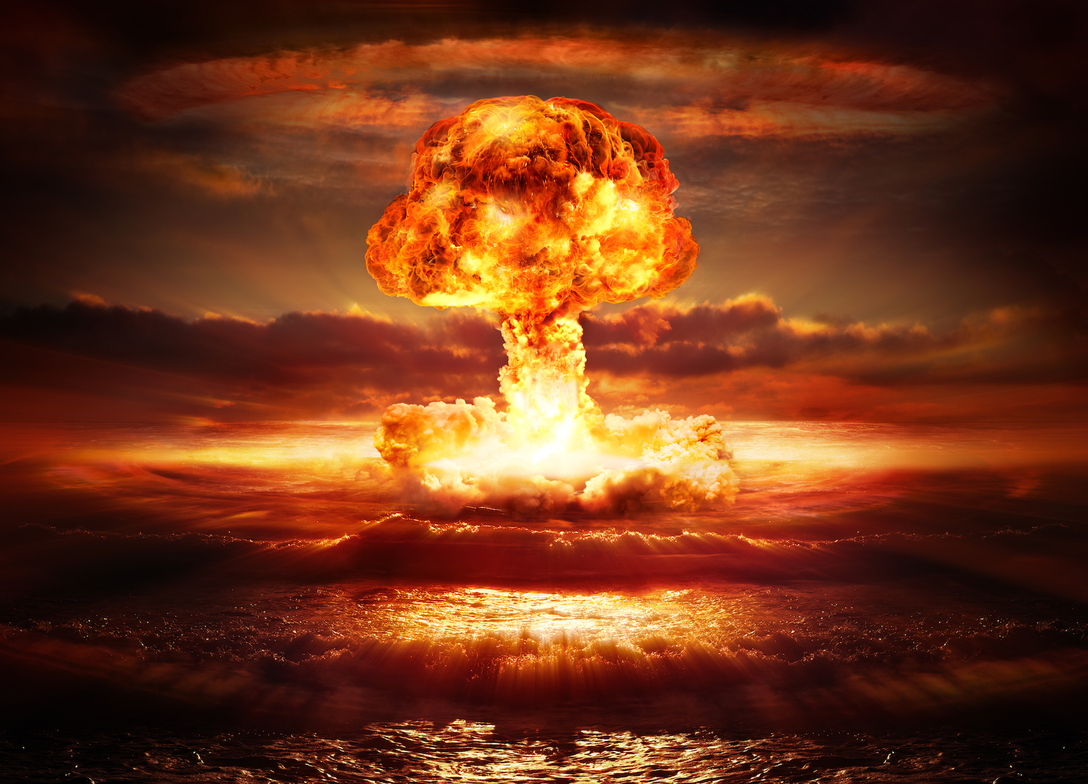
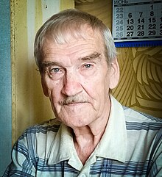
2) Insensitivity to Gradual, Long-Term Risk
Contrast the gradual impact of climate change to the “all or nothing” nature of a full out nuclear war between super-powers
which either happens or doesn’t, and if it does, it happens in one day
that kind of threat can really focus the mind!
Stanislav Petrov
September 1983, Petrov was the duty officer at the command center for one of the USSR’s nuclear early-warning systems
The system reported up to 5 missiles launched from the USA toward USSR
Protocol required Petrov to immediately inform his superiors of the attack so that they could initiate a “counter-strike”
Instead, he waited for more evidence, quite possibly saving the world

Slide 15
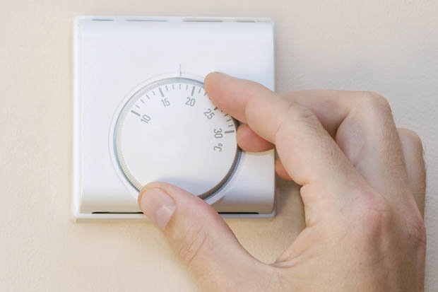
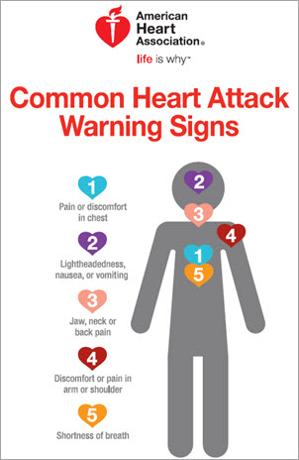
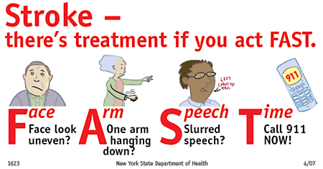
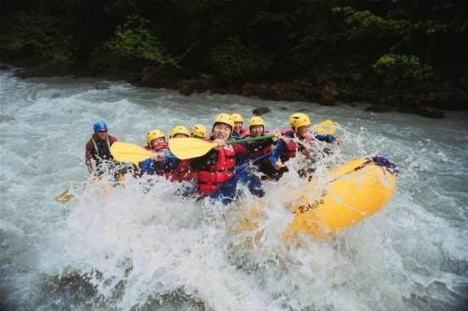
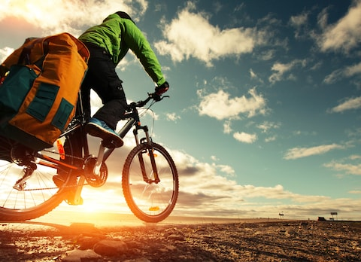
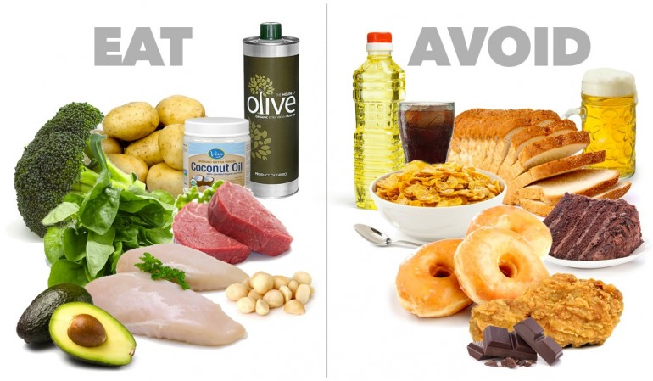
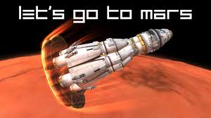
3) RISK THERMOSTATS: Differing Tolerances
My Risk-Avoidant Father
My Risk-Loving Friend

Slide 16
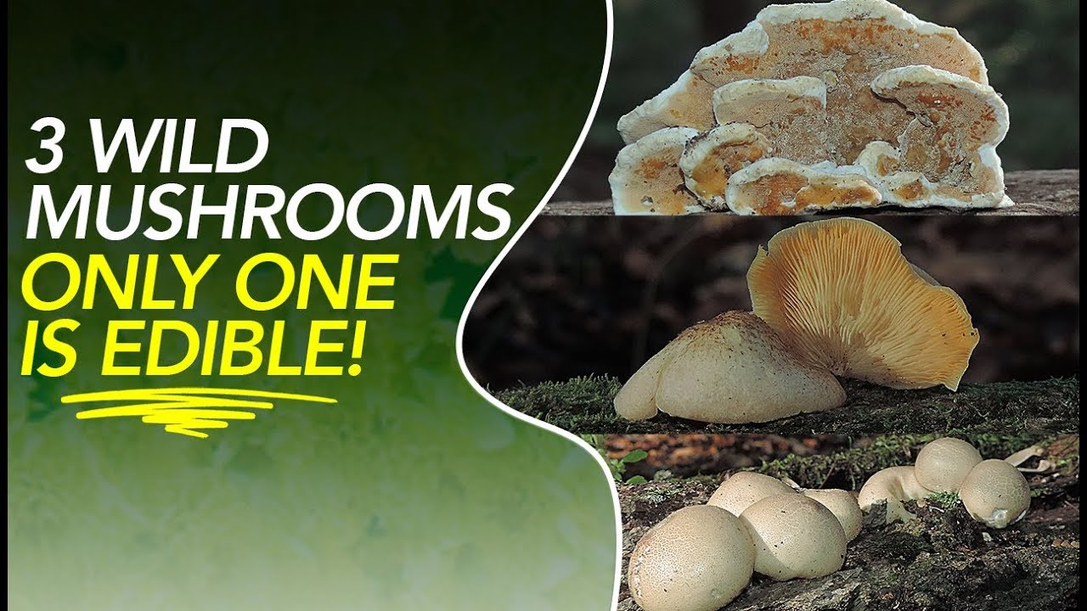
3) RISK THERMOSTATS: Differing Tolerances
Each of us has a level of risk that feels right to us
Less than this feels boring
More than this feels dangerous and reckless
Those with different settings for their ”risk-thermostats” seem crazy:
”You’re missing out on life –you’re too nervous!”
“You’re a childish thrill-seeker and you’re going to get yourself killed!”
Useful for groups to have a mix of risk-tolerances
Adventurous few find new opportunities
Cautious few keep the rest of us from following too quickly

Slide 17
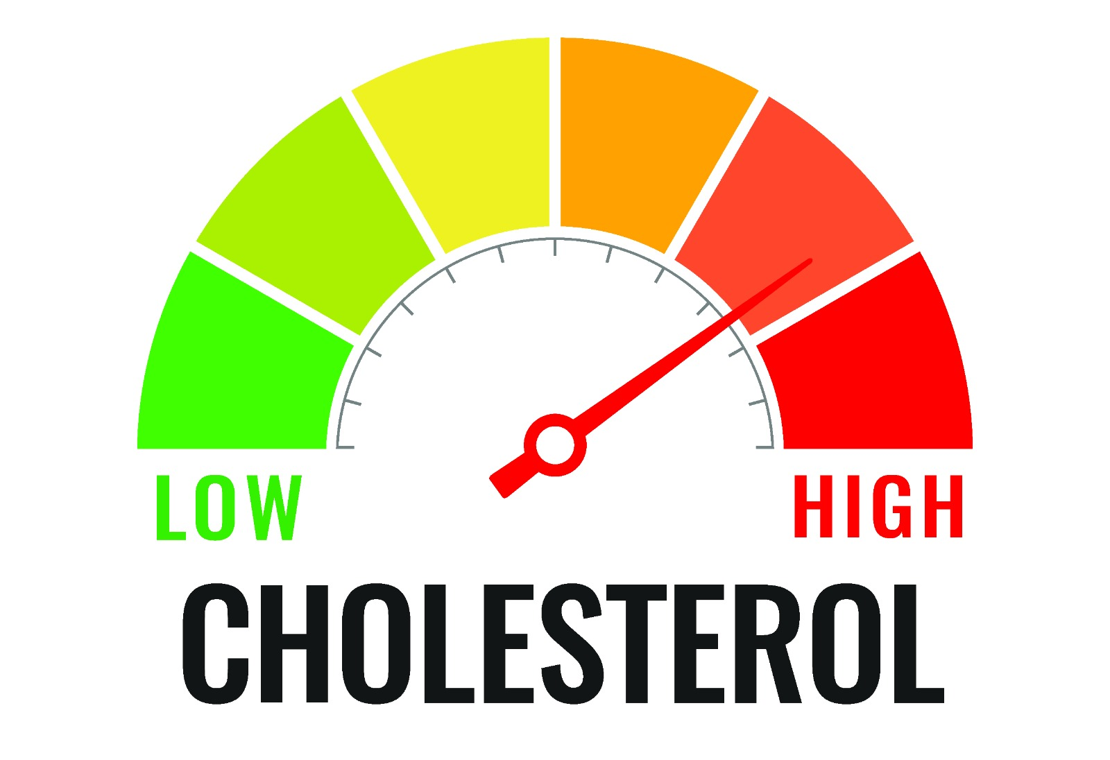
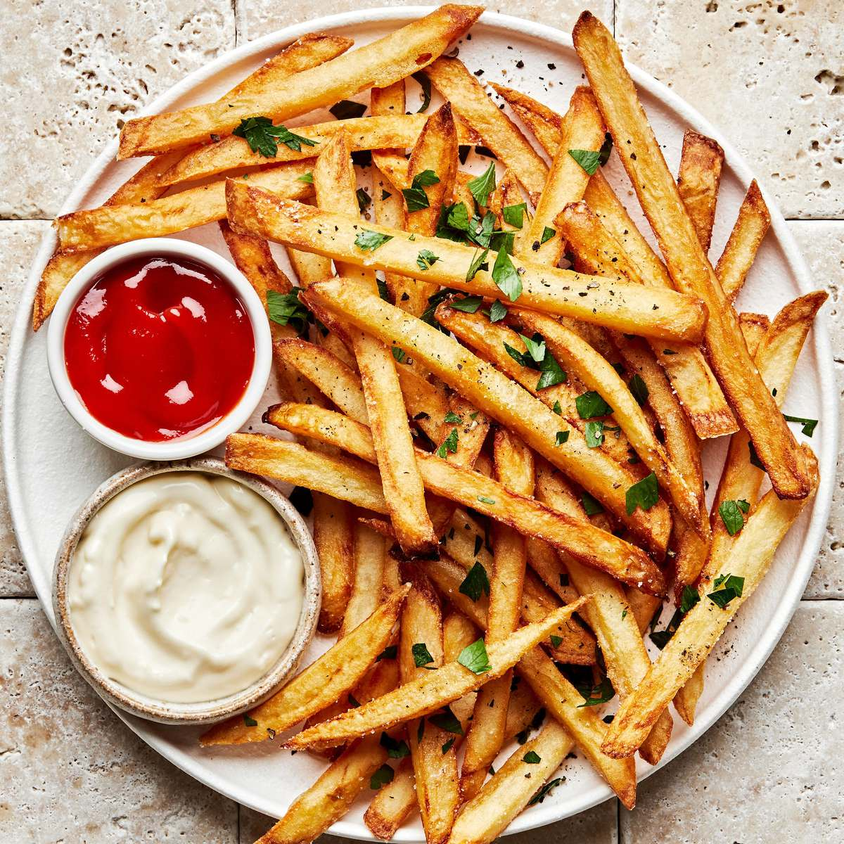
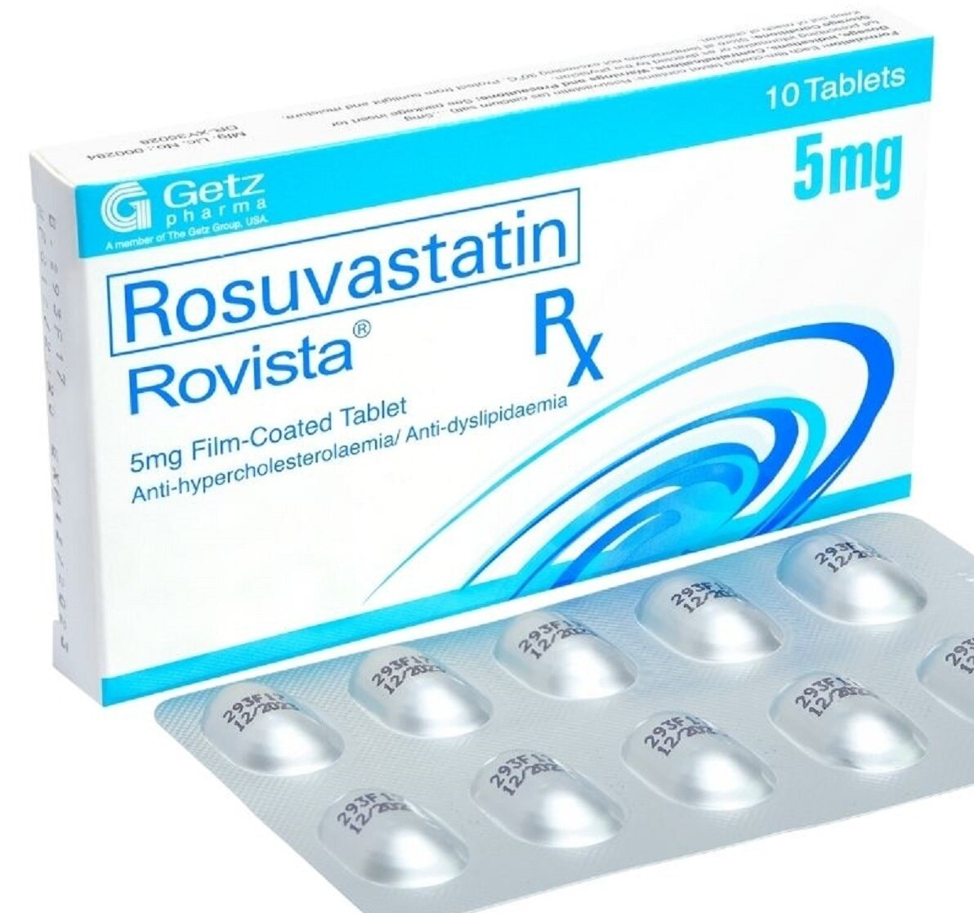
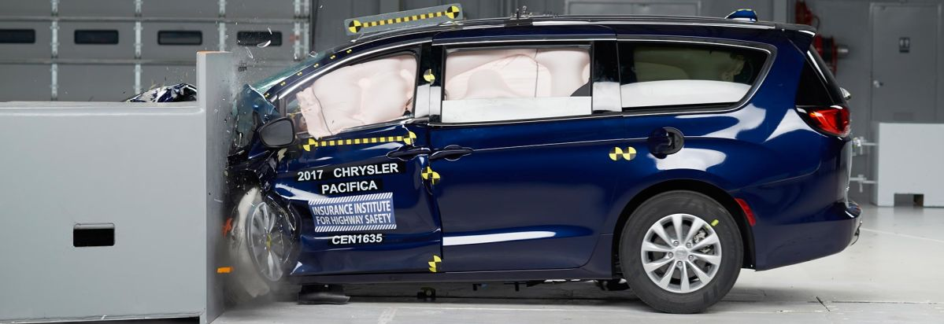
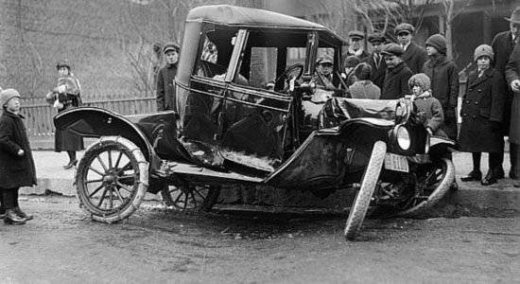
3) RISK THERMOSTATS: Differing Tolerances
We “spend” or risk-savings
As aspects of our lives become safer, we take more chances elsewhere until we return to the same overall level of risk
Every new safety feature in cars produces at least some rise in risky driving, since we feel safer

Slide 18
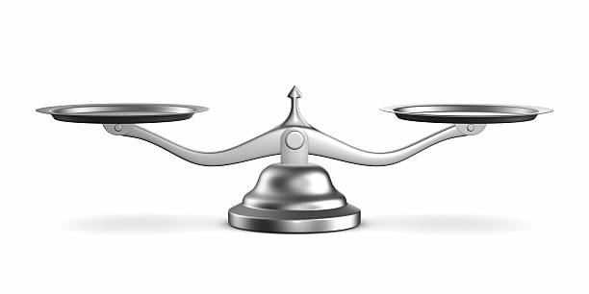
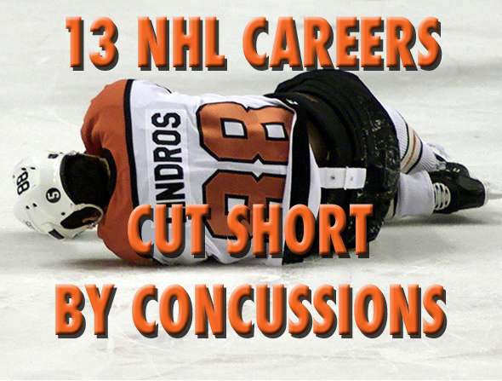
4) RISK AND VALUES
We judge risks to be lower when they are part of activities that we value
This is not the same as saying “the risks are worthwhile” –it means seeing the risks themselves as lower
If you think hockey is valuable –not just fun, but a source for something important –you are likely to think that there are fewer concussions than there really are, and that they are less severe
Hockey-haters like me are going to over-estimate those things

Slide 19
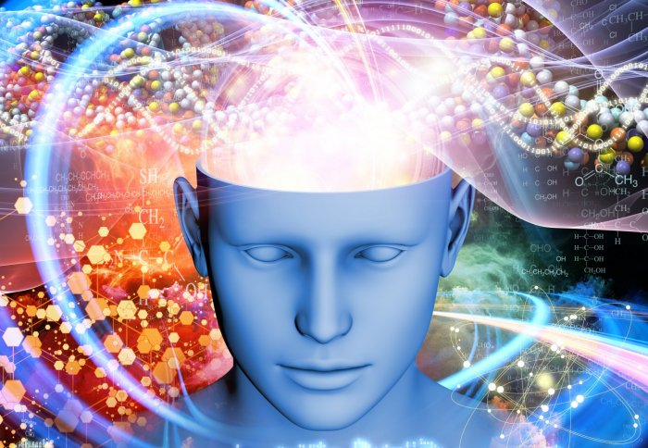
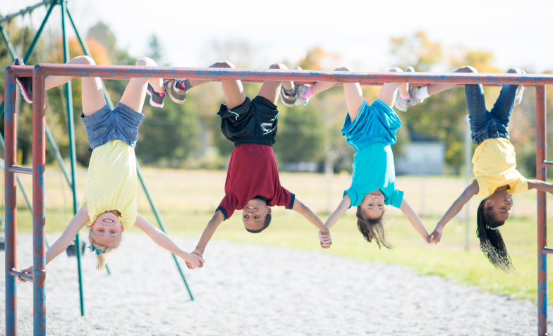
4) RISK AND VALUES
Consider your views on how “risky” it is for young children to play unsupervised on climbing structures
If you think it is really valuable for kids to do this kind of thing, you likely underestimate the number and severity of injuries
If you don’t think this is all that valuable, you likely overestimate the injuries
How risky are recreational drugs?
If you think you get something valuable from the experience, you underestimate the risks
If you think it is pointless escapism, you likely overestimate the risks

Slide 20
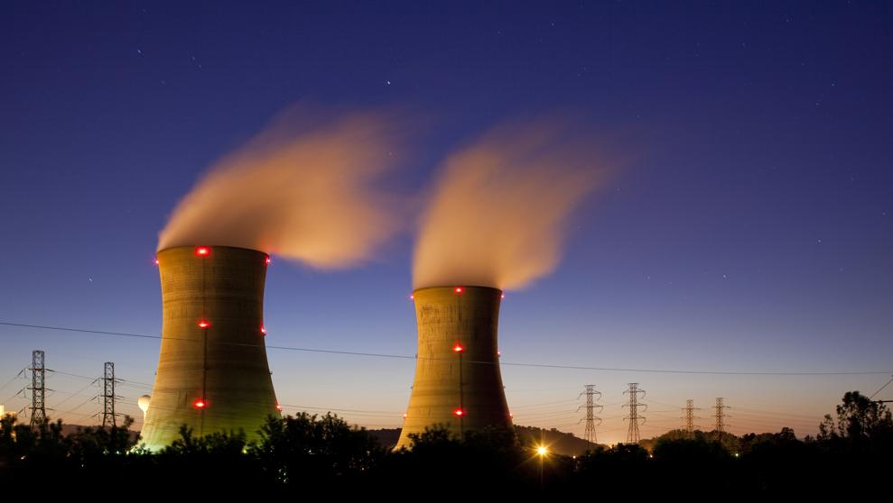
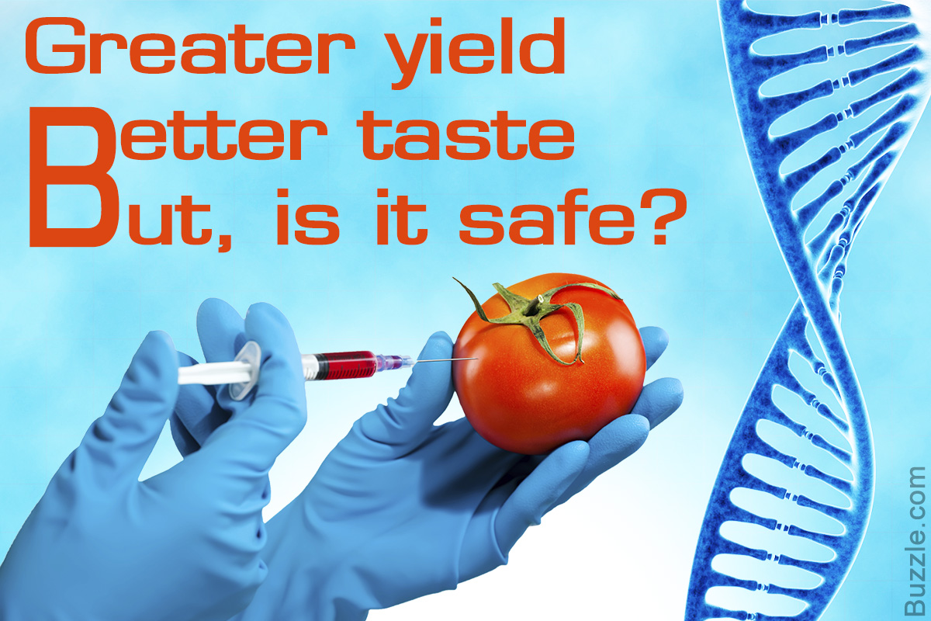
5) Artificial is Scary / Nature is Safe
We are often unrealistically nervous about anything technological or scientific
We are often unrealistically calm about anything natural or traditional
This is mysterious, since throughout our evolutionary past, the dangers we faced were all natural, and human technologies were almost never a threat (since they didn’t exist yet)
When and why did we learn this new type of fear?

Slide 21
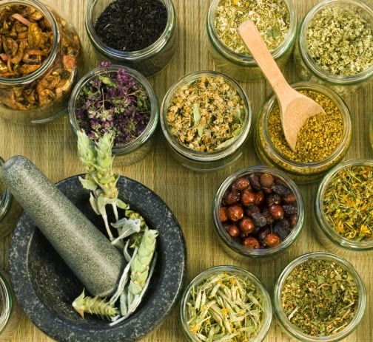
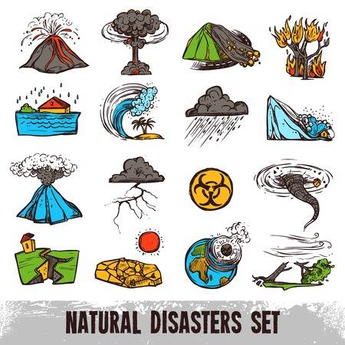
5) Artificial is Scary / Nature is Safe
Are “Natural” Remedies automatically safe? At any dose?
If so, how on earth do you think they work….?

Slide 22
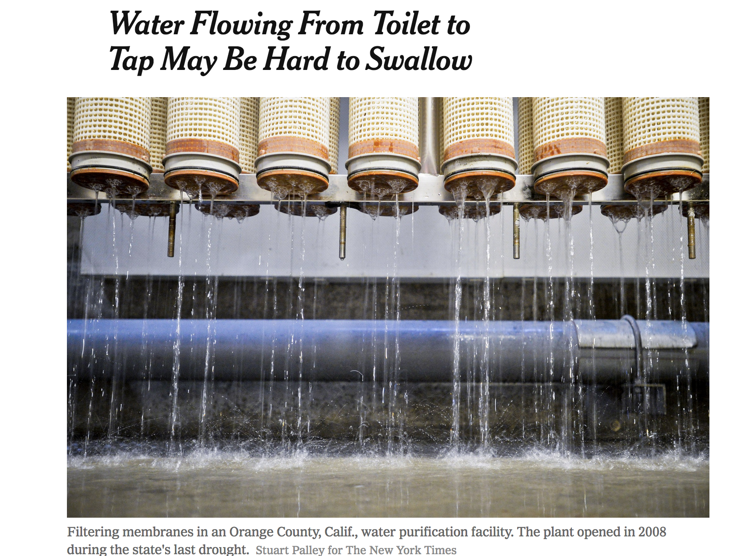
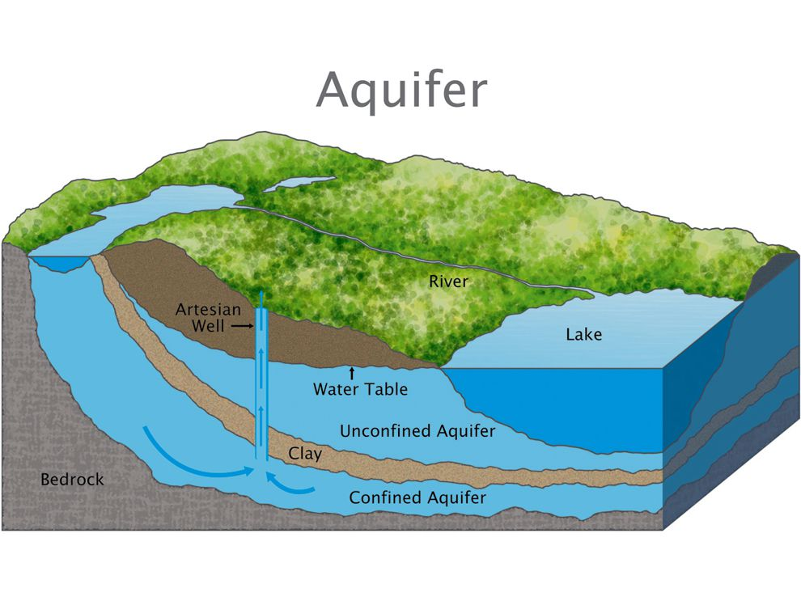
5) Artificial is Scary / Nature is Safe
In the mid 90s, Los Angels spent $55 million on a water treatment plant that produced perfectly clean water, but the public would only let them use it for farming, not drinking water
Orange County succeeded, 10 years later, by dumping treated water into underground aquifers, then pumping it out again half a mile downstream
Time in the earth makes it feel “natural” again!
https://www.nytimes.com/2015/05/12/science/recycled-drinking-water-getting-past-the-yuck-factor.html

Slide 23
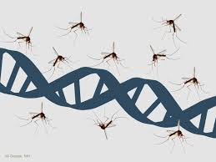
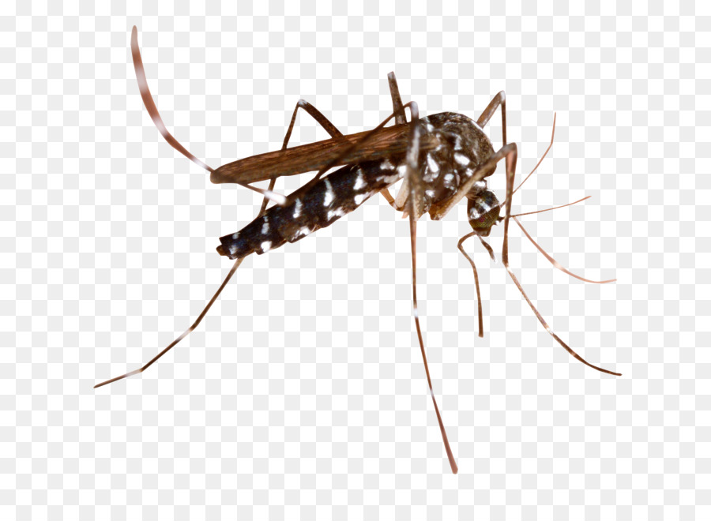
5) Artificial is Scary / Nature is Safe
ARTIFICIAL:
New ”CRISPR” genetic engineering technology could allow us to wipe out individual species of mosquitos
Science: scary, accidental doomsday, playing God…
NATURAL:
Malaria-carrying mosquitos spread a disease that kills almost half a million people a year
Natural: tragic, but acceptable, and not scary?
Which is the greater risk? If you were in charge, would you pull the switch and implement the “mosquito extinction” technology?

Slide 24
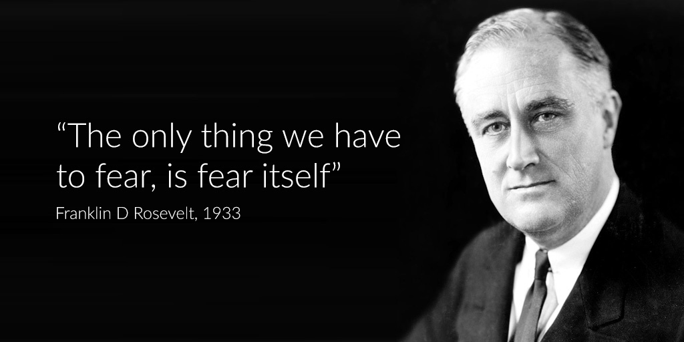
CONCLUSION
Rosevelt is certainly wrong; there is a great deal more that we should fear than just “fear itself”
As he was saying this, Germany had just elected a new chancellor... Some guy named Hitler.
That was worth worrying about!
But knowing the biases of our evolved brains equips us to take control when necessary, fighting off misleading emotional responses and their easy certainties in favour of evidence, reason, and data

