Slide 1
What Forces Shape Us?
Are we trapped, or free?
Or…
Whose fault am I?

Slide 2
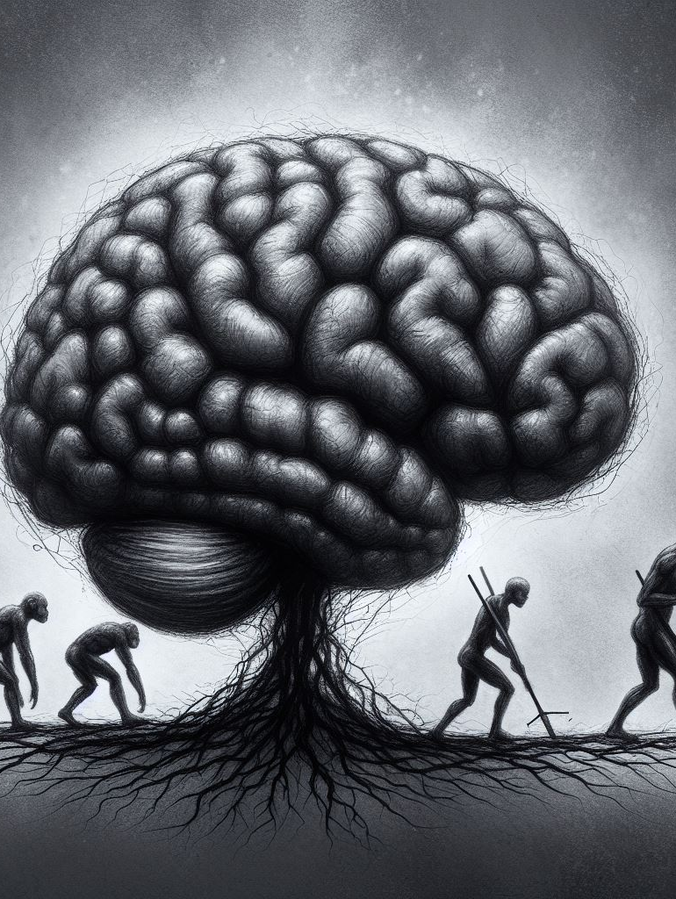
Psychological determinism
Sigmund Freud argues that we have no direct access to all parts of our selves. The “ID”, for example, often directs our behaviour without our conscious knowledge.
Evolutionary biologists argue that what our drives and preferences are just characteristics that provided an evolutionary advantage to our ancestors

Slide 3
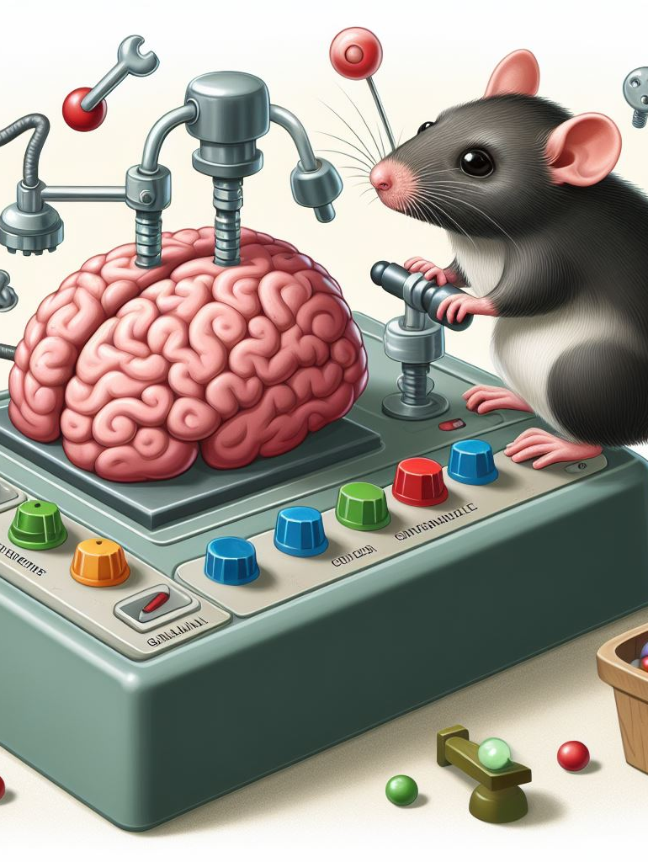
Behavioural determinism
Theorists such as John B Watson and BF Skinner argued that none of our actions are done “freely”, in that they are simply conditioned responses to stimuli. We are no more than machines with extremely complicated and thorough programming.

Slide 4
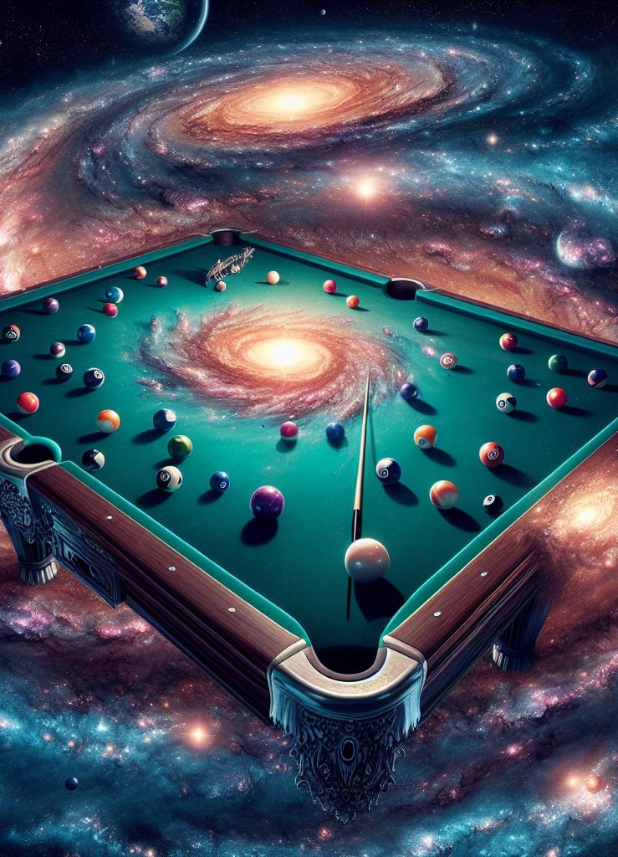
Physical determinism
•We live in an orderly universe, in which objects, and the molecular and atomic substances which compose those objects, behave in a predictable and orderly fashion.
•We are composed of the same substances as all other objects in the universe (cast off bits of stars). Why should we not obey the same laws of cause-and-effect?
•If an all-knowing and all-seeing being witnessed the beginning of the universe, she would, using the laws of physics and the starting position of each particle, be able to determine everything else that was going to happen for the rest of time. This would include the actions of all living creatures, including humans.

Slide 5
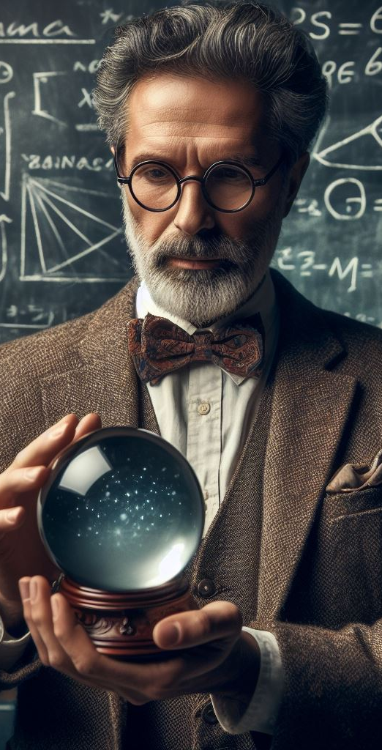
Metaphysical determinism
•Metaphysics = questions about the nature of existence and reality.
•Fate: we cannot do anything to change the past. Is the future like the past in this way? Is there destiny already written into the universe? Could we know the future the way we know the past?
•Stoicism: a metaphysical interpretation of the universe, originating in ancient Greece and Rome.
•The universe is an enormous God-machine. Everything that happens, happens for a reason. Everything that happens, must happen and could not have happened any other way.
•We may not understand the God-machine, but we play our parts. After the end of the universe, it starts again in exactly the same way, and exactly the same things happen again.
•Déjà vu.

Slide 6
Societal Forces
There are societal norms that are enforced officially and unofficially
Sometimes these norms start to seem “natural” to us, and we don’t actively question them
There are roles and assumptions placed on us, based on how we are labelled
Sometimes we internalize those roles and assumptions
A lot of those roles and assumptions are based on crooked and unfair structures

Slide 7
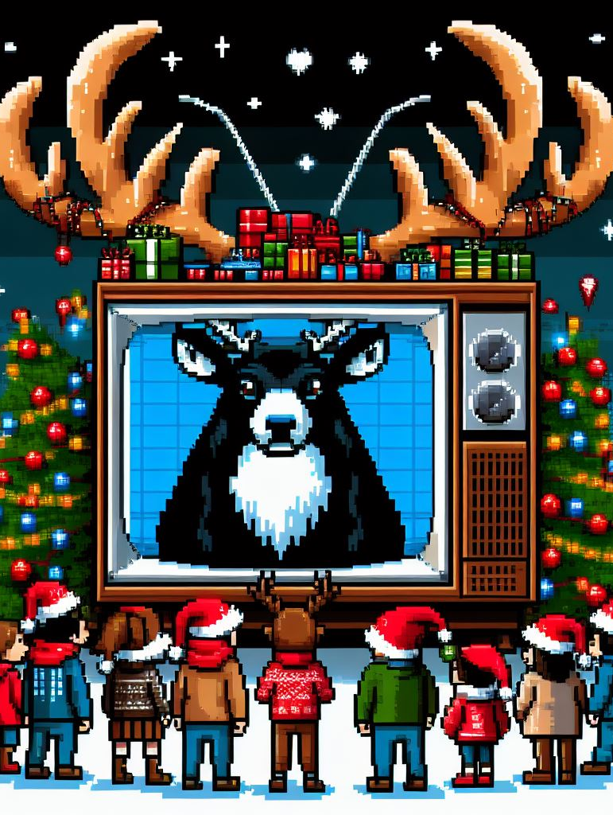
Cultural Forces
We are born into a culture, and are socialized into it by our family, education, peers, media, etc
That culture will have expectations, beliefs, mores, codes, and rituals

Slide 8
Do we have any say in who we are, or are we simply the product of exterior forces?

Slide 10
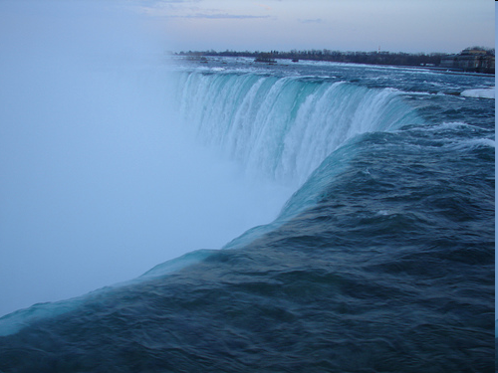

Slide 11
Are We Condemned to be Free?
The Dicewoman Experiment
1. Make a sandwich
2. Have a nap
3. Go to a movie
4. Prepare for class
5. Punch old lady in face
6. Go to the gym

Slide 12
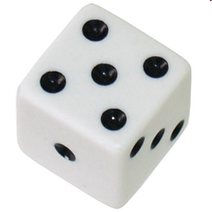

Slide 13
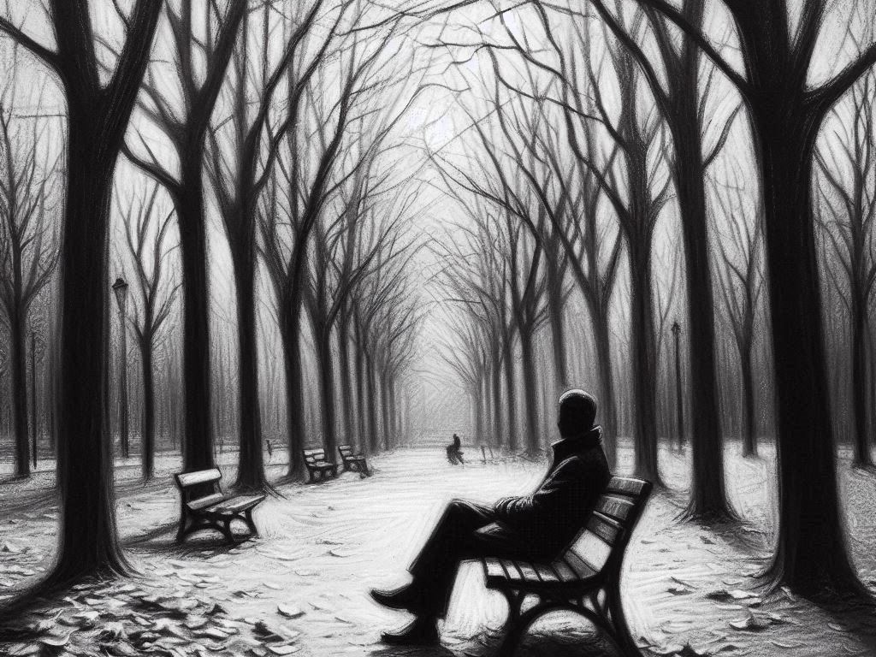
Existentialism
Horrible, Horrible Freedom

Slide 14
Warning: Nietzsche is an offensive and dangerous philosopher
You don’t need to agree with him, just understand his theory

Slide 15
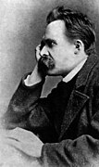
Friedrich Nietzsche
1844-1900
German philosopher
Became alarmed at the way he saw people living, and the direction he thought humanity was going
Believed people need to re-examine the way they lived
In particular, we need to examine those ideas and lies we tell ourselves to prevent ourselves from realizing our freedom

Slide 16
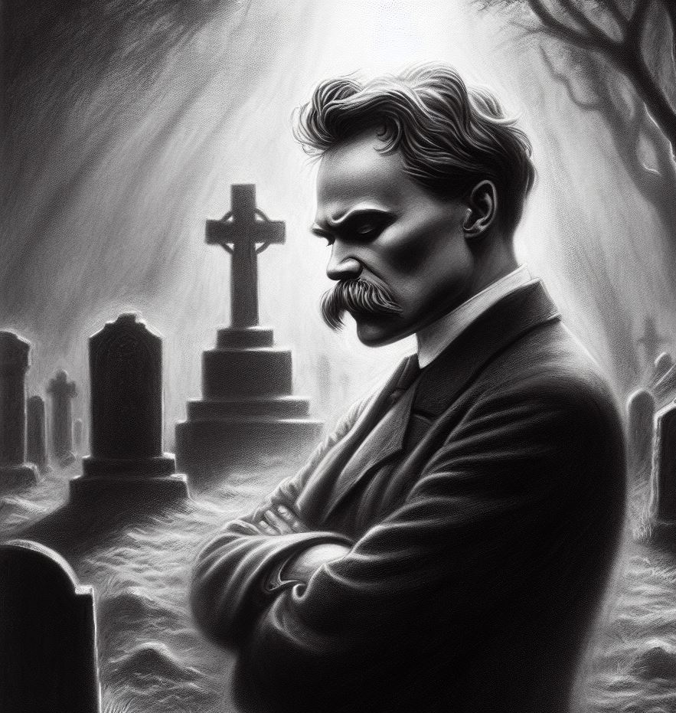
A famous passage from Nietzsche
God is dead. God remains dead. And we have killed him. How shall we comfort ourselves, the murderers of all murderers? What was holiest and mightiest of all that the world has yet owned has bled to death under our knives: who will wipe this blood off us? What water is there for us to clean ourselves? What festivals of atonement, what sacred games shall we have to invent? Is not the greatness of this deed too great for us? Must we ourselves not become gods simply to appear worthy of it?
- Nietzsche

Slide 18
What else prevents us from admitting we are free?

Slide 19
Herd Mentality

Slide 20
Slave Morality
If we consider qualities that would be thought of as “good”:
Compassion
Kindness
Humility
Honesty
Loyalty
They are qualities that are required by weak people. Nietzsche argued that weak people have pulled a trick on humanity
We must move beyond ideas of good and evil to reach our full potential

Slide 21
So, what is good?
Power
We strive for it, risk everything for it, even die for it
Power is the only true good
The “Ubermensch” (or “Overman”) would recognize this, and escape both the herd mentality and slave morality

Slide 22
Nietzsche gets Badly Misinterpreted

Slide 23
What Hitler Got Wrong (Partial List)
Nietzsche did not mean you should try to have power over other people
Needing other people to realize your ideas is a sign of weakness, not strength
“I have found strength where one does not look for it: in simple, mild, and pleasant people, without the least desire to rule—and, conversely, the desire to rule has often appeared to me a sign of inward weakness: they fear their own slave soul and shroud it in a royal cloak (in the end, they still become the slaves of their followers, their fame, etc.)”
Nietzsche

Slide 24
The Herd

Slide 25
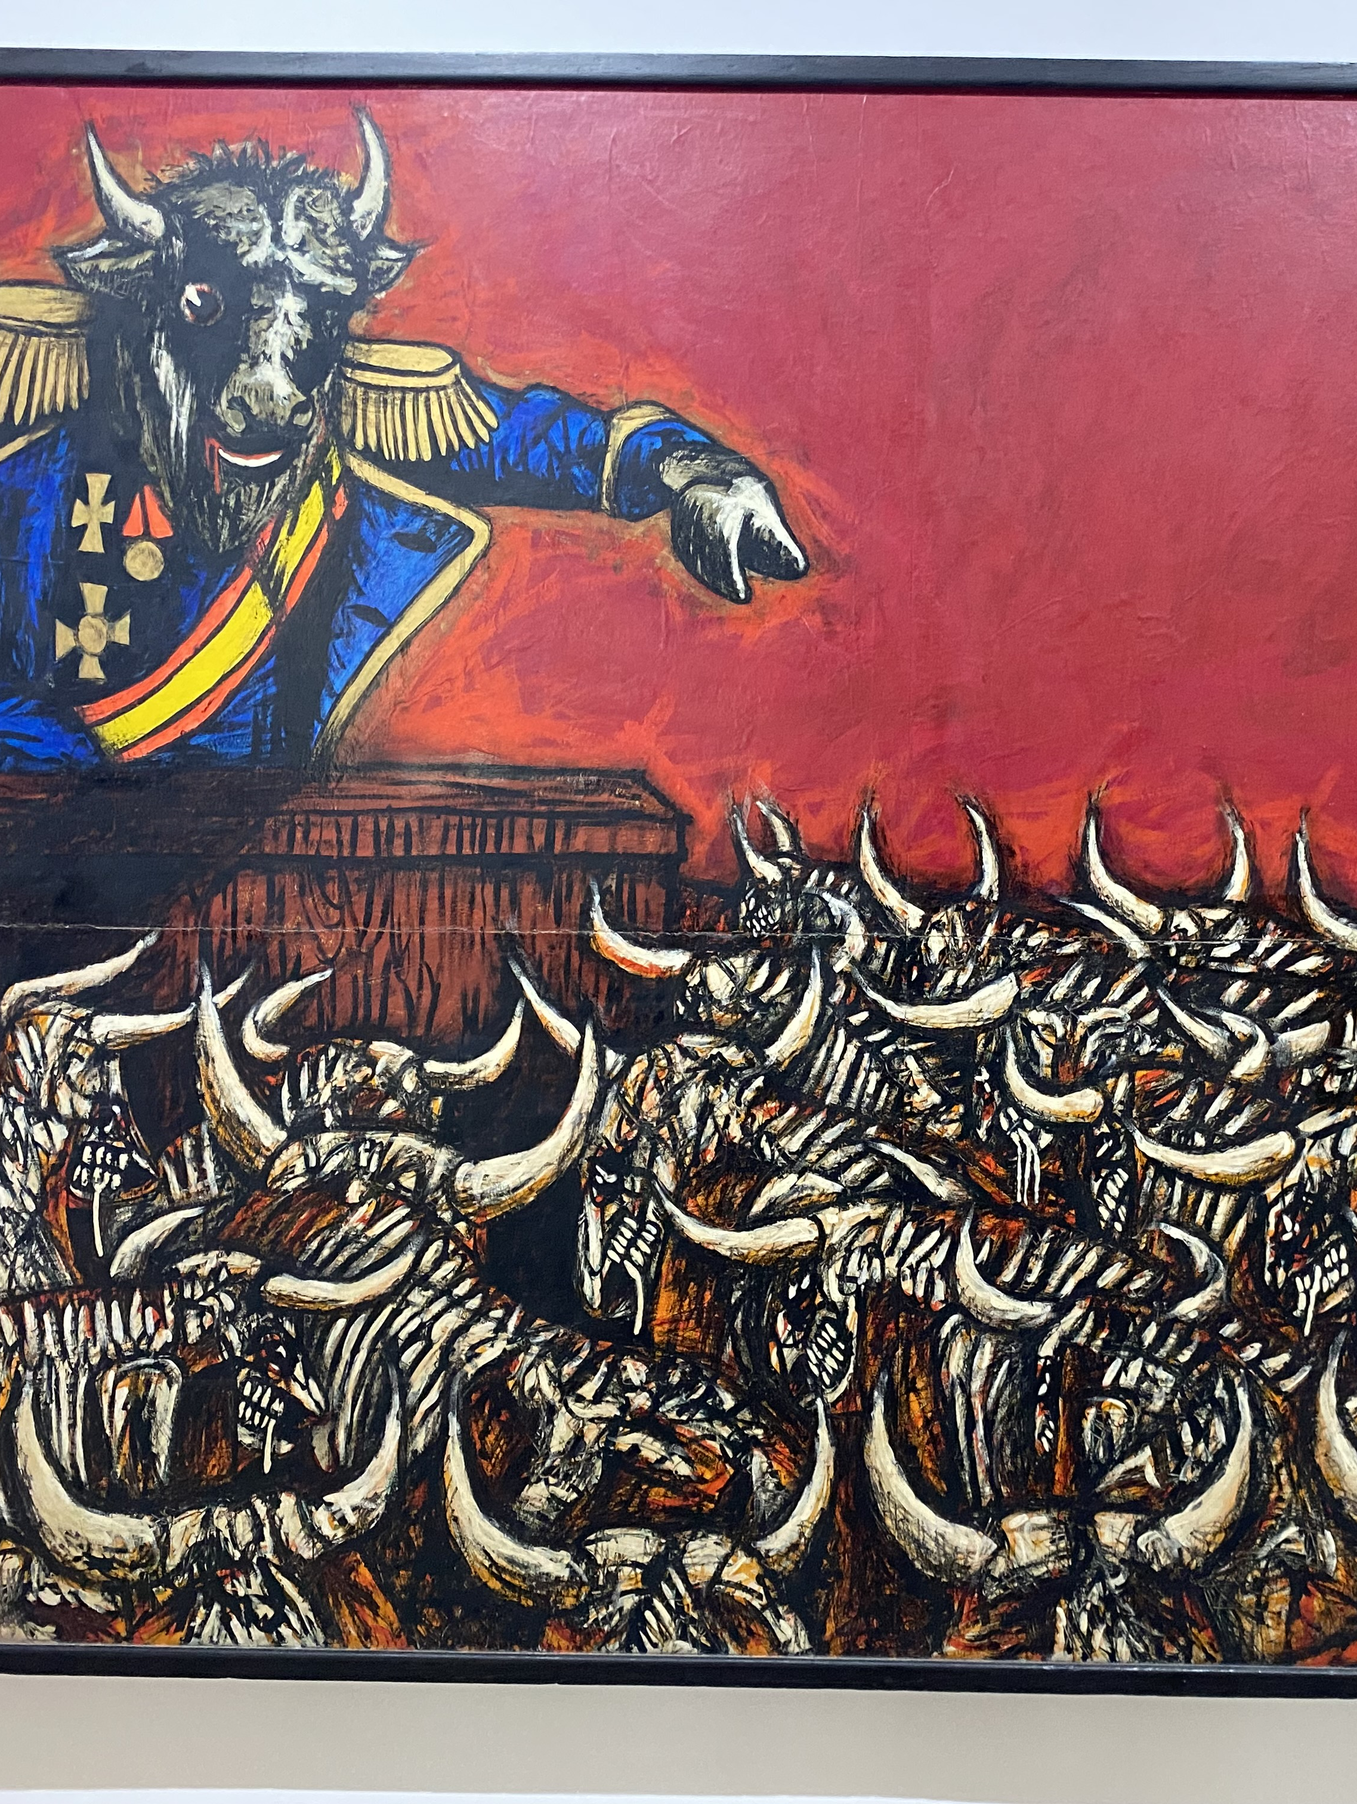
Fascism isn’t it
Wearing the same uniform, chanting slogans, forming angry mobs = herd mentality
El Gran Fascista
Rafael Zarza 1973

Slide 26
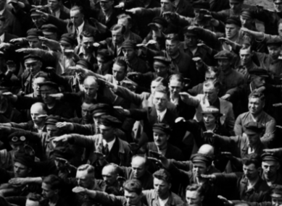
An Ubermensch?

Slide 27
So What the %@&#?
We are responsible for deciding in what kind of world we want to live, and for acting in a way that makes that world
We should live as if we will have to live exactly the same way, again and again, forever (the “myth of eternal recurrence”)
Our lives are blank canvasses, on which we paint ourselves through our actions
“Either we have no dreams or our dreams are interesting. We should learn to arrange our waking life the same way: nothing or interesting”

Slide 28
Existentialism
Existence precedes essence
We are what we do
Here’s a true story about cowardice…

Slide 30
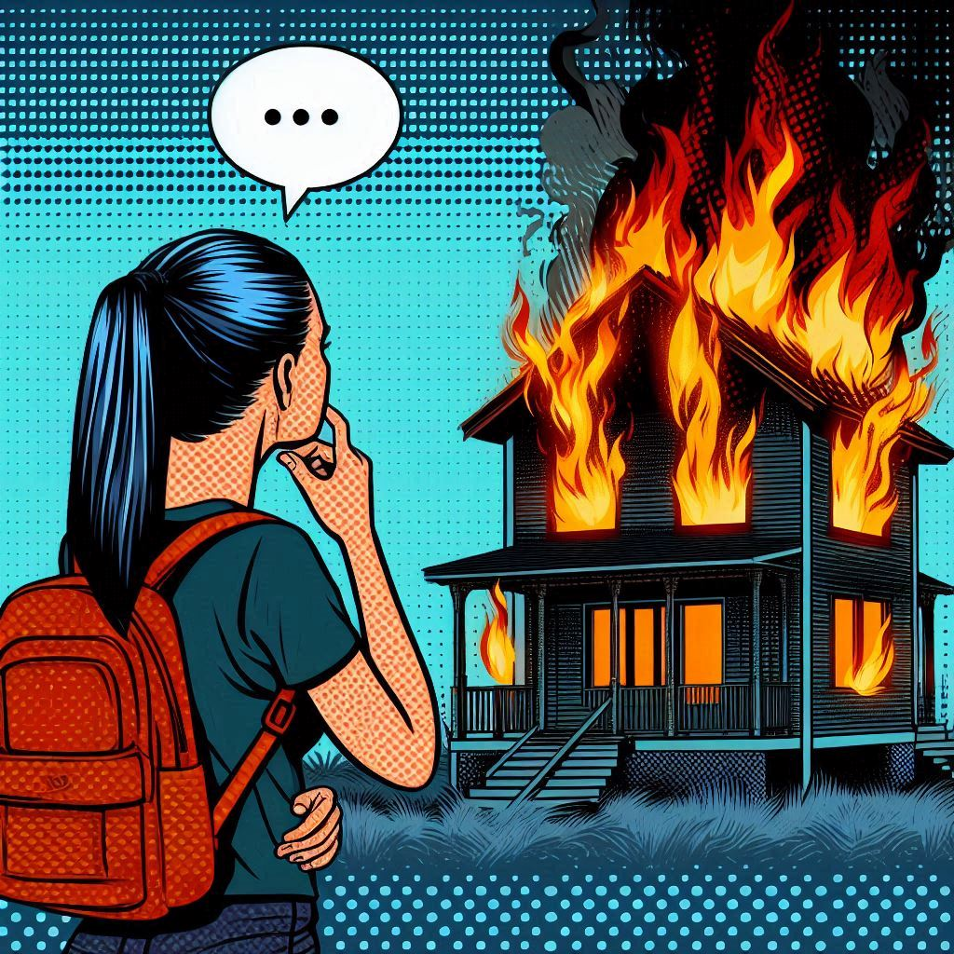
Existentialism
Non-existential sentence:
I couldn’t go into the burning house, because I am a coward
Existential sentence
I choose not to go into the burning house, therefore making myself a coward today

Slide 31
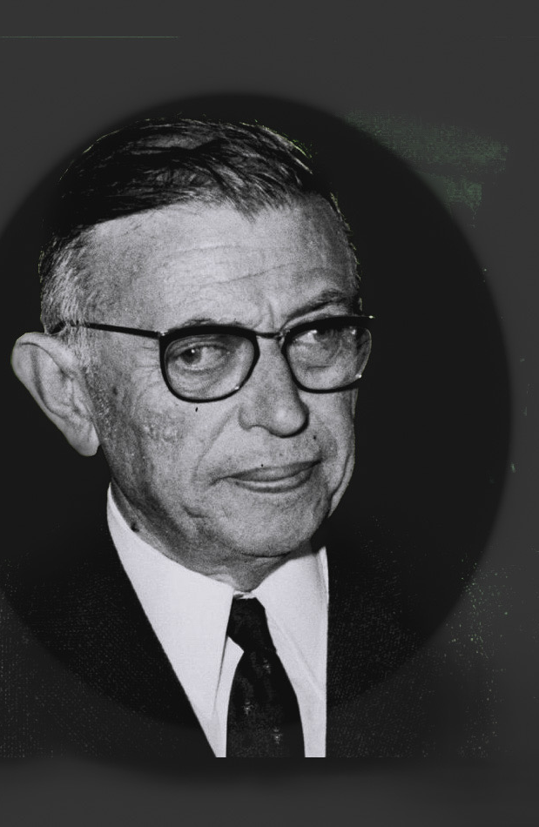
Existentialism Continued…
It is “bad faith” (a term that comes from existentialist Jean-Paul Sartre) to say we “are” something, so therefore we “can’t” or “couldn’t” do something
Freedom is what you do with what has been done to you

Slide 32
The last thing Nietzsche did before going insane and wasting away
He was on the street, and saw a man whipping a tired horse.
He threw himself between the man and the horse, and then collapsed

