Slide 1








Welcome !!

Slide 2

UNIT 2 – What Makes us Who We Are?

Slide 3
Anxiety
4 Perspectives:
Psychoanalytic - oldest
Behavioural
Cognitive
Neurobiological

Slide 4
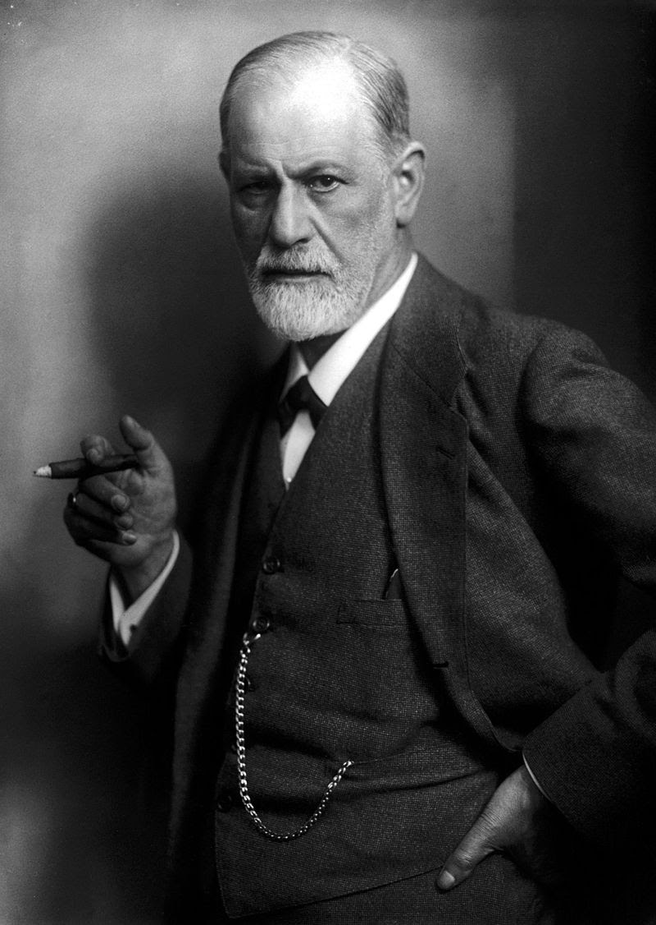
Psychoanalytic
“The root of Anxiety is the fear of death”

Slide 5
Psychoanalytic –
Freud’s Definition (1890) Anxiety Neurosis
Irritability
Deeply engrained and distressing pessimism: the belief that ‘disaster is just around the corner’. Freud called this trait ‘anxious expectation’.
Panic attacks – difficulty breathing, pains in the chest, sweating, vertigo and trembling.
Waking up at night in fear.
Vertigo – feels like the ground is rocking or legs giving way

Slide 6
Psychoanalytic – Freud’s Definition (1890) Anxiety Neurosis cont’d
Phobiass
Feelings of nausea, ravenous hunger, or diarrhea
Tingling of the skin (pins and needles) or numbness.

Slide 7
Psychoanalytic – Freud’s Emerging Definitions
His views changed over the decades.
In 1932, he claimed that anxiety still has roots in sexual causes, but it’s primarily caused by psychological (mind/thoughts) factors.
‘Anxiety’ (response to actual danger in external environment) vs. ‘Neurotic Anxiety‘ (excessive and irrational in internal environment).

Slide 8
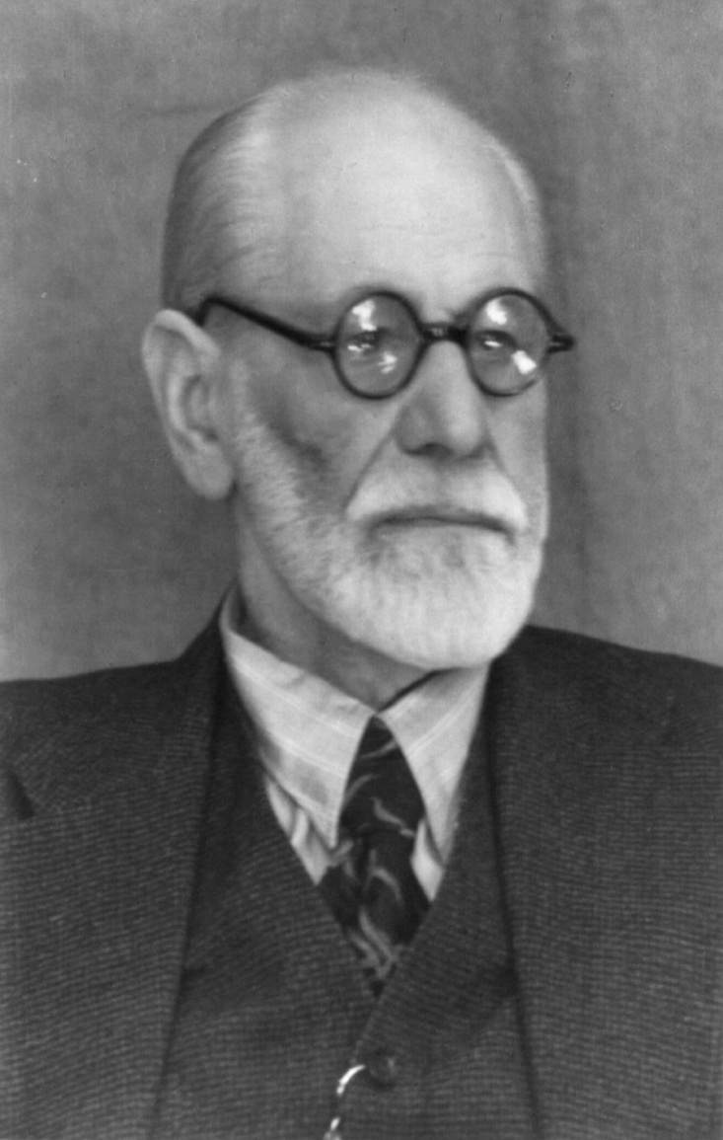
Distinguishing the Types
Anxiety - helps us – Lion, run!
Neurotic Anxiety – makes our lives miserable.
The root of every neurotic anxiety is the fear of an external danger.
The root of every anxiety is fear.

Slide 9
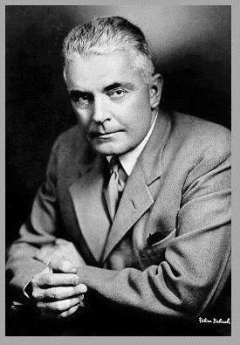
Next Perspective – Behaviourists
Anxiety is a learned response – O.H. Mowrer.
John B. Watson (in image) was the founder of the behaviourist school of thought in psychology. This has dominated academic psych for much of the 20th century.
If we can’t see it or measure it, then we don’t know it is real.

Slide 10
Types of Learning – for this lecture
Classical Conditioning
Operant Conditioning

Slide 11
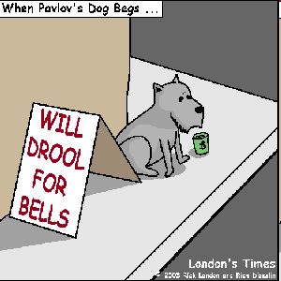
Classical Conditioning

Slide 12
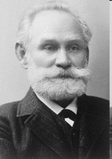
Ivan Pavlov (1849 – 1936)
Russian physiologist, psychologist and physician
In 1904, awarded the Nobel Prize in Physiology or Medicine for research on the digestive system
“Next time there is a revolution…”

Slide 13
1. Classical Conditioning (cont’d)
Pavlov is most famous for describing classical conditioning
Discovered “by accident”
Studying gastric function and salivary response in dogs
Noticed something interesting… the dogs would start salivating when the research assistant feeding them entered the room (before they could even smell the meat)

Slide 14
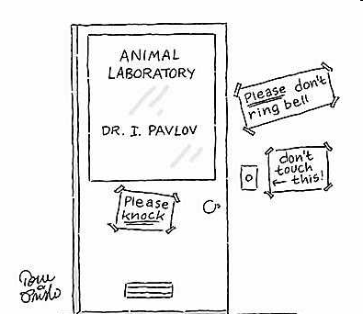

Slide 15
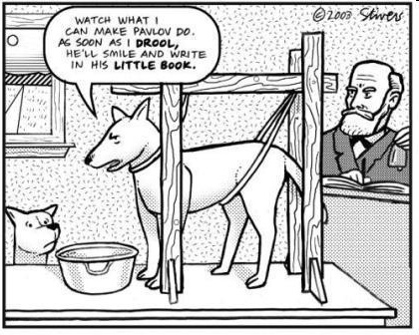

Slide 16
What is Classical Conditioning (CC)?
… form of learning in which an association is formed between one stimulus and another.
Stimulus = any event or object in the environment
KEY in CC → the association between stimuli

Slide 17
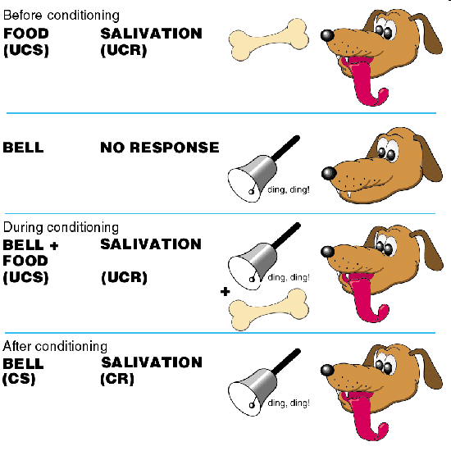

Slide 18

Other (human) Examples?
Conditioned fears (and even phobias)
  bitten by a dog in childhood, now afraid of dogs
Taste aversion
Celebrities used to sell products
David Beckham and Modeling/Influencing many brands.

Slide 19
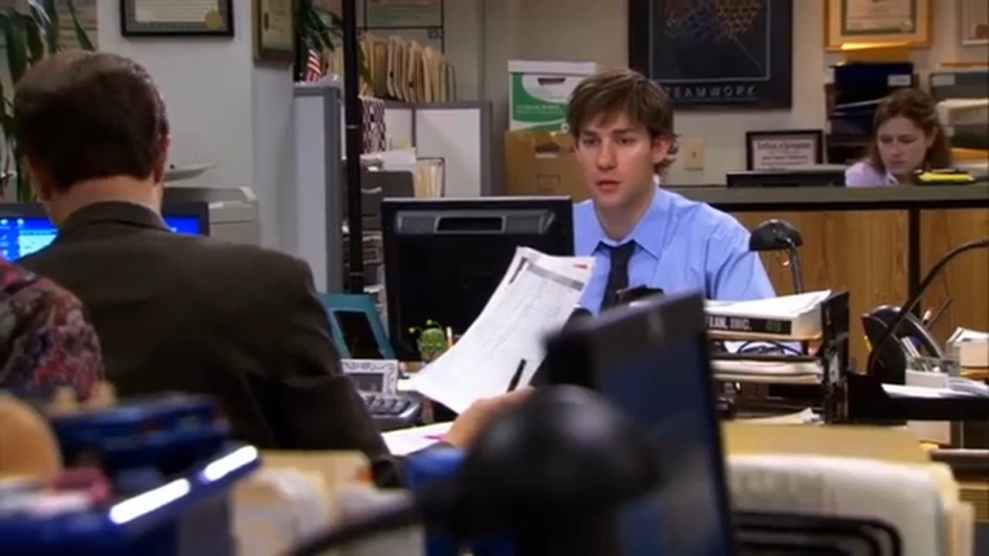

Slide 20
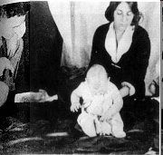
Conditioning Little Albert
Johns Hopkins University, 1919
John Watson claimed that he could condition a child to fear some distinctive stimulus which normally would not be feared by a child by using classical conditioning.

Slide 21


Slide 23


LOOK FAMILIAR?

Slide 24
Operant Conditioning

Slide 25
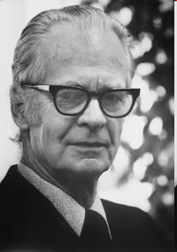
Operant Conditioning
B. F. Skinner
… the consequences of behavior are manipulated in order to increase or decrease the frequency of a response or to shape an entirely new response.

Slide 26
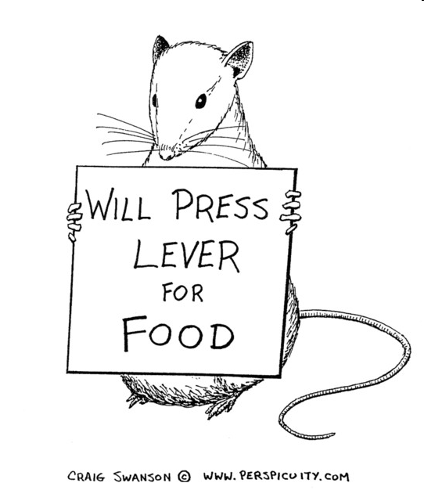
Reinforcer / Reinforcing Stimulus
Anything that follows a response that increases the likelihood that the response will occur again.

Slide 27

Shaping
Reinforcing or rewarding successive approximations of the desired response.
Watch a video (next slide):
Older footage
  https://www.youtube.com/watch?v=mm5FGrQEyBY
Notes:
http://www.youtube.com/watch?v=mm5FGrQEyBY

Slide 28
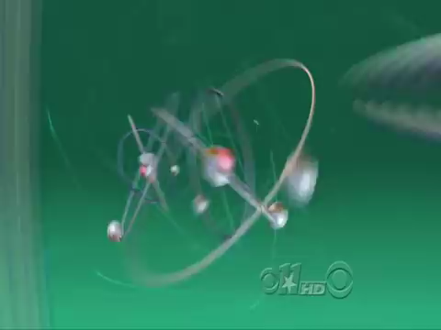
Notes:
http://www.youtube.com/watch?v=mm5FGrQEyBY

Slide 29
Types of Reinforcement
Positive reinforcement
  any pleasant consequence
  if applied after a response, increases the probability of that response occurring again.
  Something desirable is ADDED (+) to your environment

Slide 30
Types of Reinforcement
Negative reinforcement
  behaviour that is likely to occur again because it was followed by the termination of an aversive condition.
  Something undesirable was REMOVED (-) from your environment

Slide 31
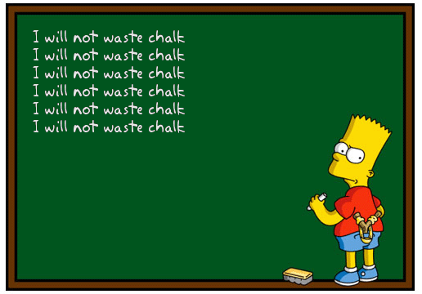
Punishment
Punishment is anything that follows a response, that decreases the probability that the response will occur again.

Slide 32
Punishment (cont’d)
Positive punishment → the presentation (addition) of an aversive stimulus.
Something undesirable is ADDED (+) to your environment
E.g. parking ticket, spanking
Negative punishment → the removal (subtraction) of a rewarding stimulus
Something desirable is REMOVED (-) from your environment
E.g. being grounded, no TV or internet privileges

Slide 33

The Take Home Point?
We know from behaviourism that anxiety can be learned.
We also learnt that we can un-learn the fear.
Behavioural desensitization
A person who was once very afraid of something can now face the fear, or ‘do' the activity.

Slide 34
The Next Perspective – Cognitive
(1956 onwards)
The legacy of behaviourism -> CBT, another way to unlearn the anxiety.
Cognitive Theories of Anxiety: “Emotions are experienced as a result of the way in which events are interpreted or appraised.
It is the meaning of events that triggers emotions rather than the events themselves. The particular appraisal made will depend on the context in which an event occurs, the mood the person is in at the time it occurs and the person’s past experiences. “

Slide 35
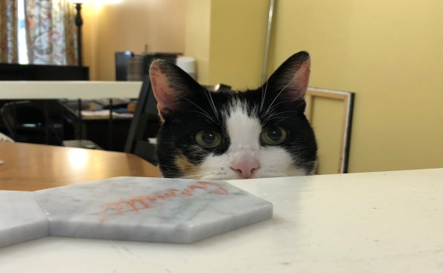
Your Turn: Example of an Appraisal
Imagine, for example, that you are woken in the early hours of the morning by a noise downstairs. Is it a cat or intruder?

Slide 36
Answer:
How you interpret that noise will determine your emotional response.
If you decide it’s your cat clattering around, you might feel mild irritation at being disturbed before turning over and going back to sleep. But if you believe it may be the sound of a burglar, you’ll almost considerably be gripped by anxiety and lie awake wondering whether you ought to investigate.

Slide 37
Detection of threat – Cognitive
May not be conscious but more intuitive based.
When we detect a threat that we think cannot handle, then we feel anxiety.
Example: Panic attacks – their mind’s appraisal of the physical symptom is incorrect.
The thoughts behind it make it more than it is and then contribute to a cycle. A negative feedback loop.

Slide 38
Aaron T. Beck – Father of CBT
Why does one person assume a noise in the middle of the night is nothing to worry about, and another find themselves paralyzed by anxiety?
Answer: schematic beliefs (preconceptions, ideas, and habitual thought processes, beliefs).
They are so ingrained and automatic, that most of us are unaware that this is the problem!

Slide 39
Examples of negative cognitive schemas:
It’s always wisest to assume the worst
Trouble can strike at any moment
I’m a vulnerable person
I must be in control

Slide 40
Negative Thoughts in Academics:
I’m not good enough to pass or get this diploma, degree
I think I will fail my test or assignments
The other students are smarter or better than me
What if I …oh my God! I’m going to fail! I’m not good enough.
The other students hate me or are better than me
The teacher hates me
I’ll never get this, or get into this career and make money.

Slide 41
Aaron Beck said:
If we believe these thoughts, then we’re overestimating the threat & underestimating our capacity to cope with it.
More Positive Examples :
  I’m exactly where I’m supposed to be.
  God gives people what they can handle
  I will learn, and get this course, diploma, degree
  I will pass, and if I don’t, I can always take something again or get extra help.
  I will do well.
  I will take each task one step at a time.

Slide 42
Last perspective - Neurobiological
Areas of the brain which have been found to effect anxiety:
Amygdala (part of limbic system – our brain’s area to make sense of threats and react, something from our early evolution to ensure survival). Stores unconscious fear memories. Fight or Flight!
Frontal Lobes – planning, make sense of everything, and how to react.
Hippocampus – memory center of the brain

Slide 43
Neurobiological
The Amygdala also works with the hypothalamus (influencing basic processes of the autonomic nervous system – breathing, blood pressure and body temperature).
Changes to autonomic nervous system when we’re anxious can lead to a wide range of physical effects including elevated heart rate, dilated pupils and altered breathing.
High Road reaction vs. Low Road reaction (we may react and not know why).

Slide 44
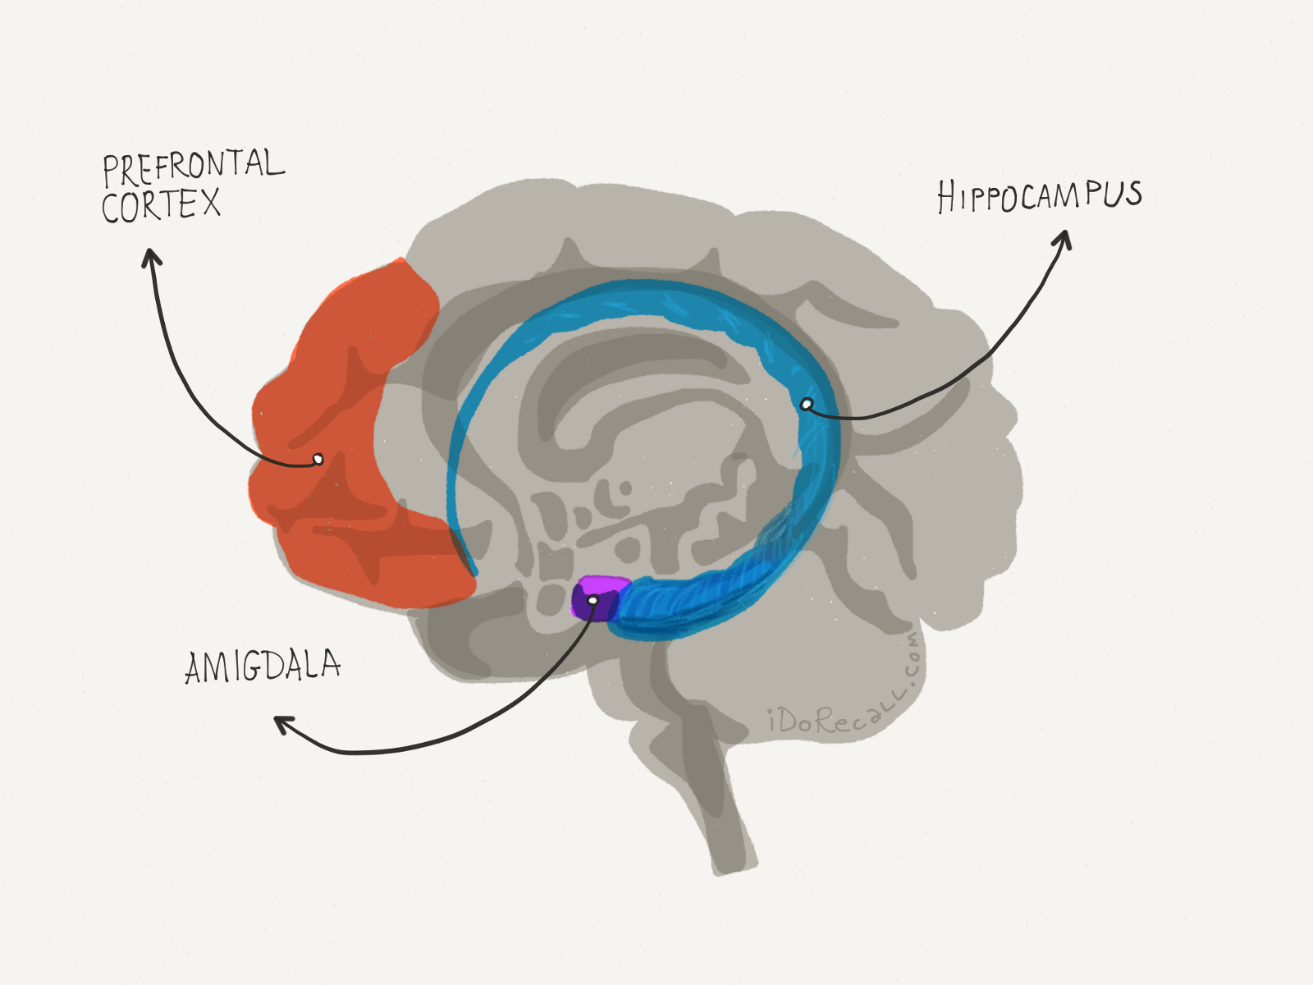

Slide 45
Neurobiological- The Limbic System
When the Amygdala does its job and appraises something as a threat, hormones are released like. Cortisol and Adrenalin to help us escape or fight danger (fight, flight or freeze).
If we are always on alert, then we are in a toxic stress situation.
GABA neurotransmitters are involved in calming us down when we’re anxious.
Doctor’s can prescribe medications to assist in these areas. SSRIS SNRIs.

Slide 46

In Conclusion
All perspectives have their merits.
What about Mindfulness?

