Slide 1
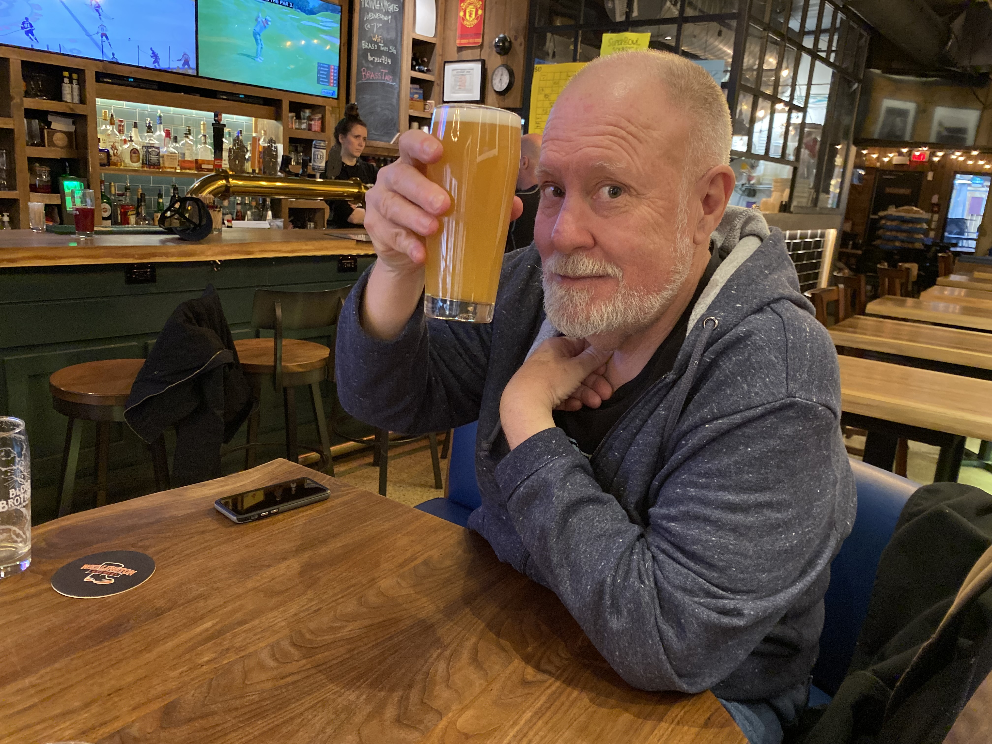
A quick recap
Unit 1: What can we know?
Unit 2: What are we?
Unit 3: What is this place?
Unit 4: What’s the point?

Slide 2
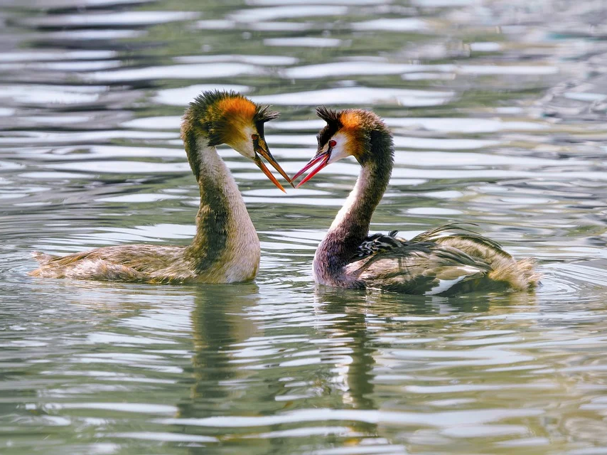
Love and Romance

Slide 3
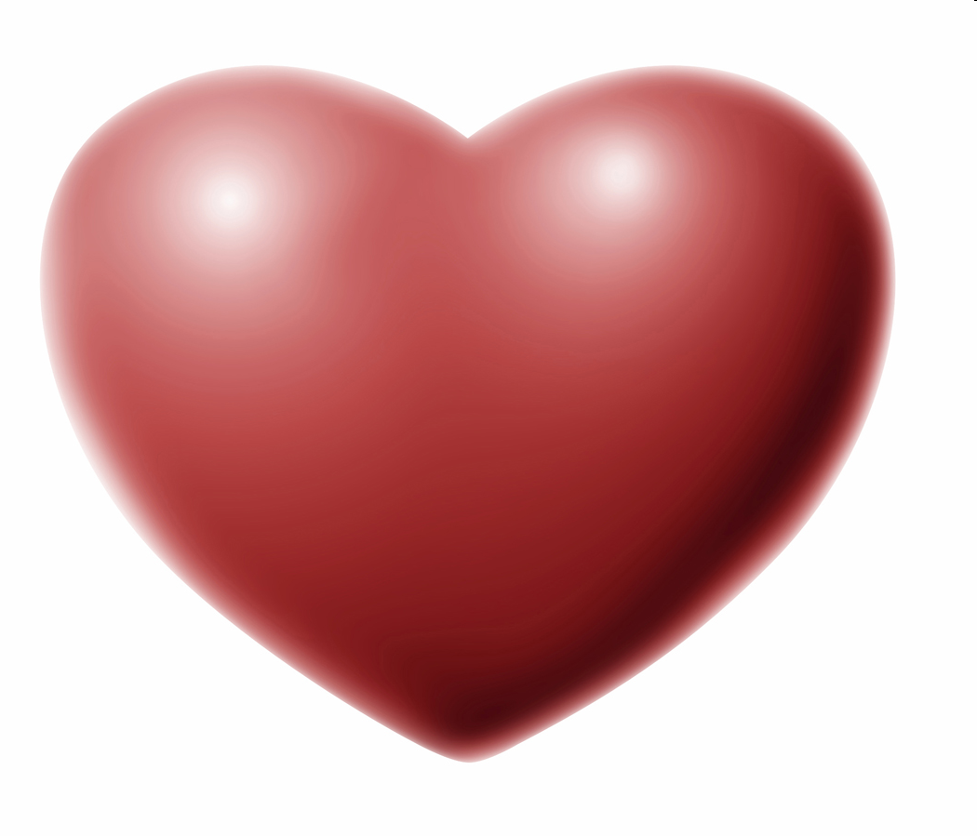

Slide 4
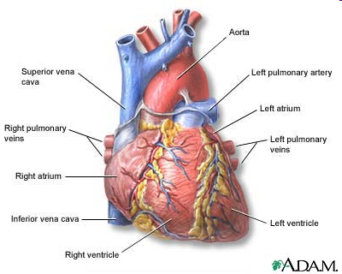

Slide 5
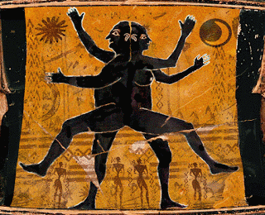
What is Love? - Aristophanes
Story from Plato’s “Symposium”
In ancient times, people had 4 arms, 4 legs, 2 faces, 2 sets of genitals
They spent their days cartwheeling around having sexual intercourse
There was always someone to talk to
The Gods became angry of what are good time we were having, and cursed us
We were split in two

Slide 6
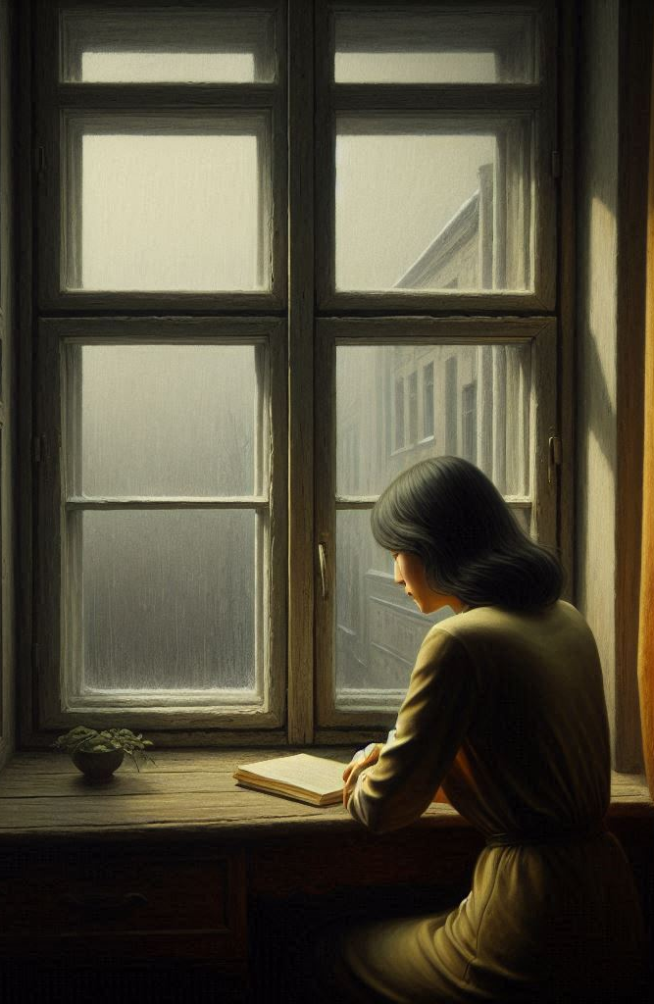
This story is obviously untrue
However, it isn’t meant to be taken literally
Instead, it is meant to describe in an artistic manner the experience of being a human being
In particular, the powerful “pull” we often feel towards another human being
Also, the loneliness we can feel on our own

Slide 7
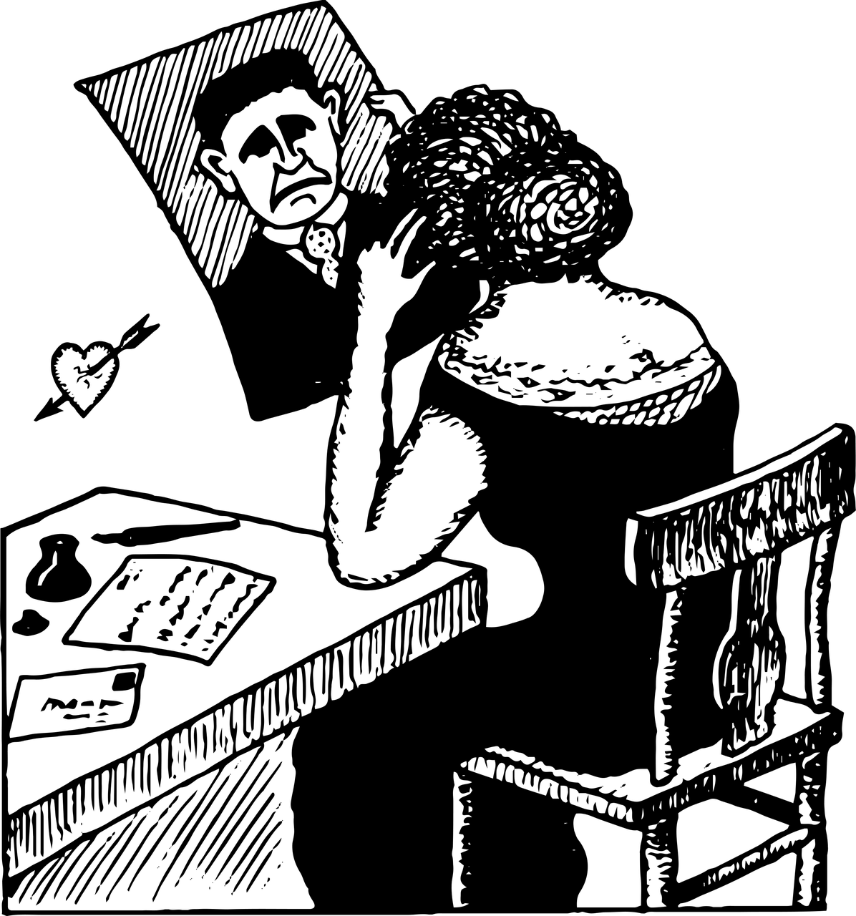
Infatuation
“…a panopoly of intense emotions, roller-coasting from high to low, hinged to the pendulum of a single being whose whims command you, to the detriment of everything around you – including work, family, and friends.”
From the Fisher reading

Slide 8
Can infatuation become obsession?
Limerence

Slide 9
Love vs Limerence
Love
Limerence
Interest
Reasonably realistic view of the other person as a person
Still able to live a balanced life
Excitement and affection are main emotions, based on forming a relationship with another person
Obsession
Idealized version of the other person
All consuming
Anxiety and fear are main emotions, based on the potential loss or disinterest of the limerence object

Slide 10
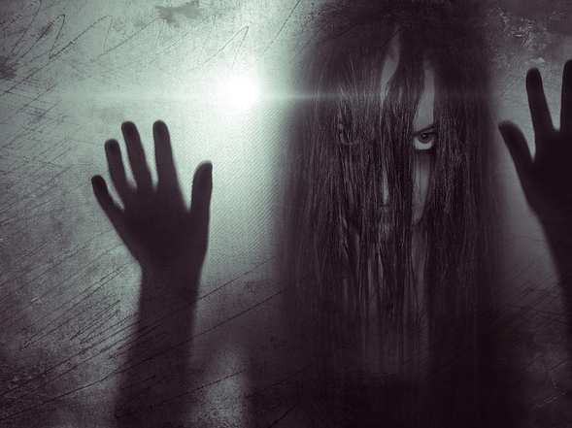
Typical Symptoms of Limerence
Intrusive thoughts
Intense jealousy
High-risk behavior
Roller coaster emotions

Slide 11
However, even a non-limerence crush has a touch of limerence to it…

Slide 12
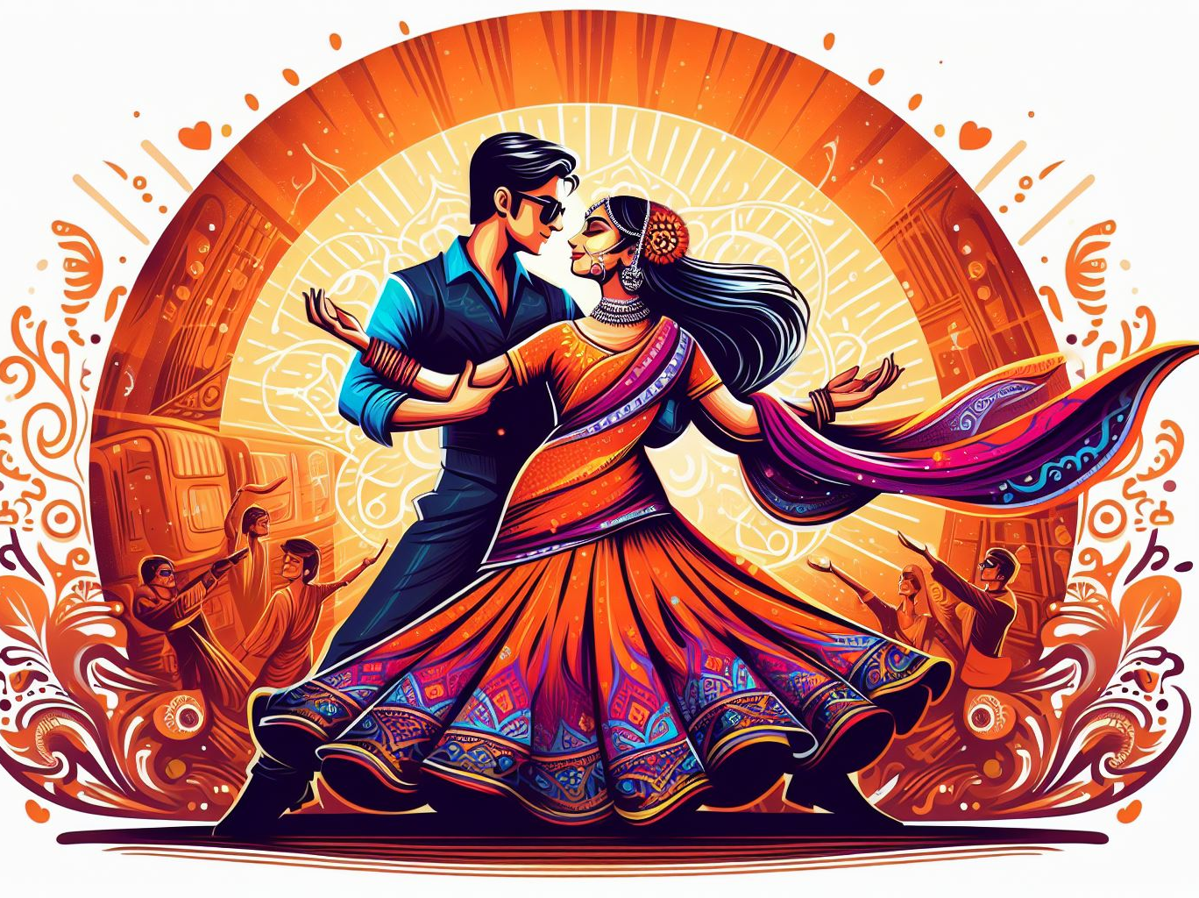
The chase
Barriers (distance, family or societal pressures, taboos) often intensify feelings of interest
Increased levels of testosterone, adrenaline
The appeal of another person “playing hard to get”
Our competitive nature is most prevalent in this stage
What happens after the chase is over, and the relationship begins? Can you now feel secure?

Slide 13
The sweetest agony
Tonight I came back to the hotel alone; the other has decided to return later on. The anxieties are already here, like the poison already prepared (jealousy, abandonment, restlessness); they merely wait for a little time to pass in order to be able to declare themselves with some propriety. I pick up a book and take a sleeping pill, "calmly." The silence of this huge hotel is echoing, indifferent, idiotic (faint murmur of draining bathtubs); the furniture and the lamps are stupid; nothing friendly that might warm…
Roland Barthes

Slide 14
Good news: the pain will recede
(Bad news, the excitement will recede)

Slide 15
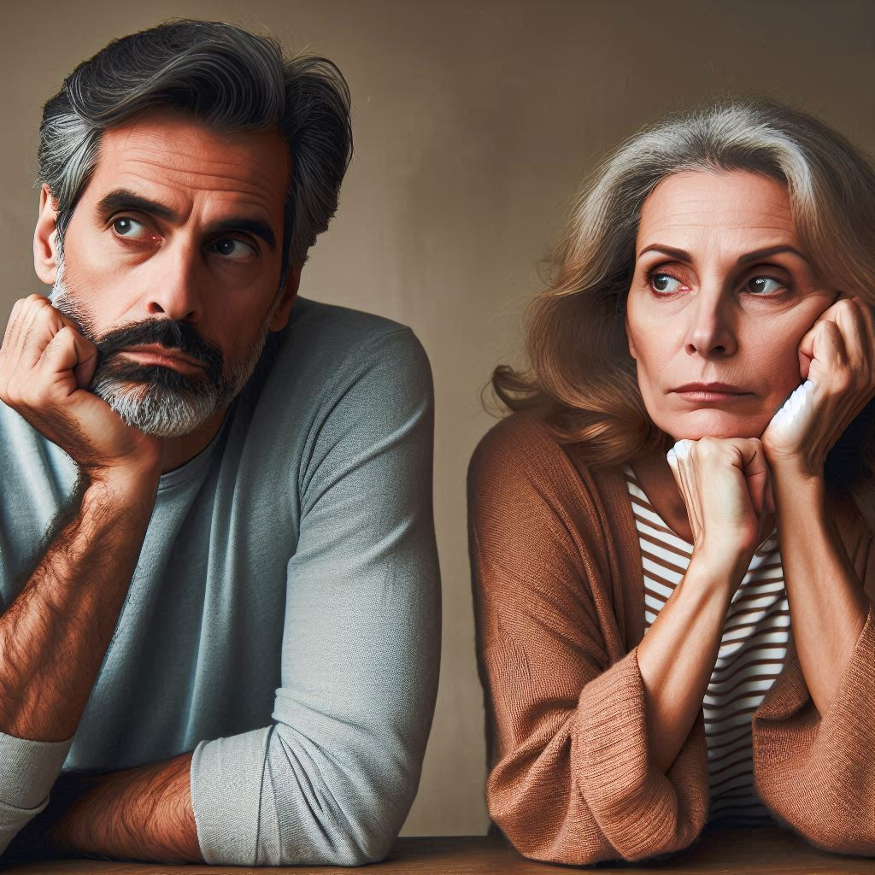
Attachment
This is the stage in which bonding occurs
Fear, panic, and excitement are replaced by trust and routine and a “feeling of neutrality”
This stage normally takes between 18 months and 3 years to emerge
The moment at which “Netflix and chill” literally means you are going to watch Netflix and chill

Slide 16
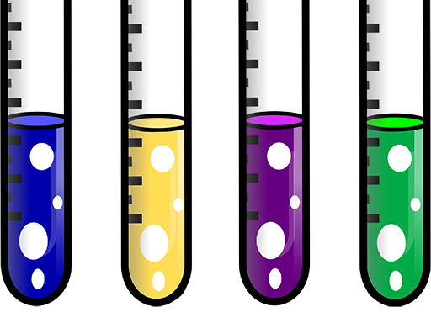
From a chemical perspective, what happens when we fall in (and out of) love?

Slide 17
Infatuation
Phenylethylamine
Nervous system stimulant
Adrenaline
Increases heartbeat, respiration in preparation for action
Testosterone
Energy and sex drive

Slide 18
In love
Dopamine
Reward chemical
Seratonin
Emotion regulation

Slide 19
Bonding and attachment
Oxytocin
Love and trust
Vasopressin
Encourages monogamy
Endorphins
Relieve pain and stress

Slide 20
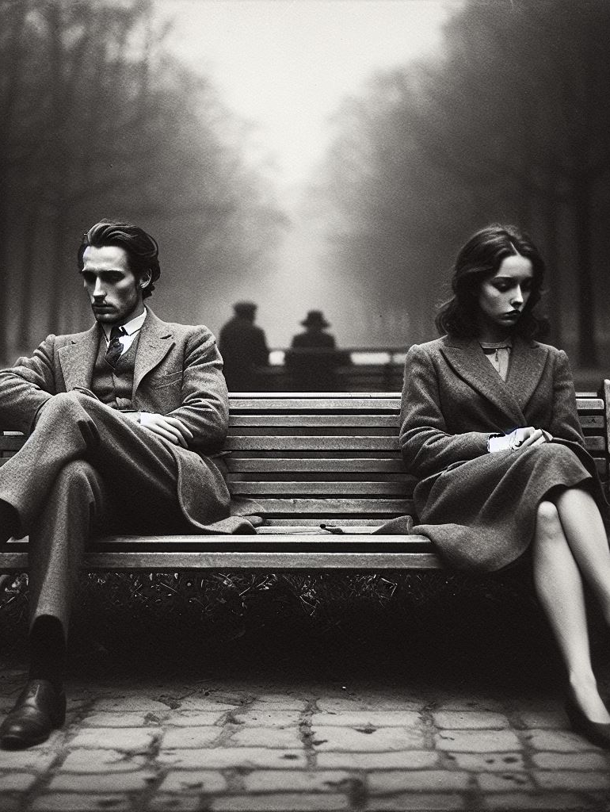
The End of Passion
What is left after the excitement is over?
Chemistry vs compatibility
2nd law of thermodynamics again…

