Slide 1
Why are you here?

Slide 2
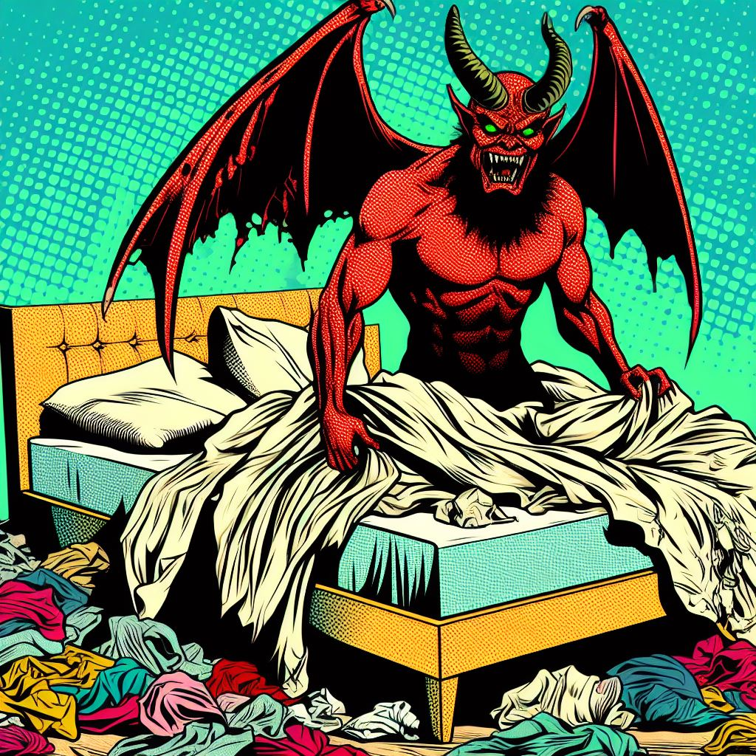
Small Scale Entropy
Making the bed every morning

Slide 3
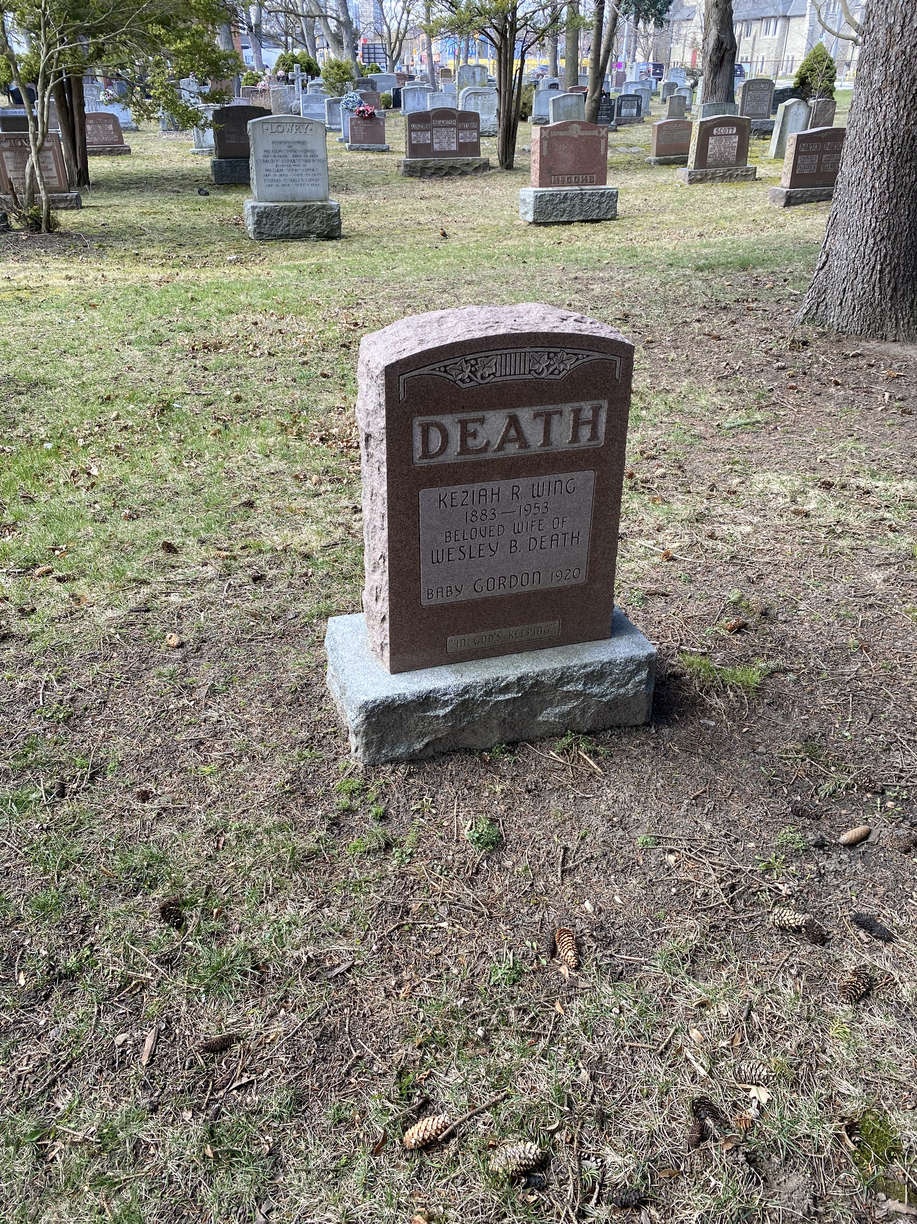
Medium Scale Entropy
All of us will die

Slide 4
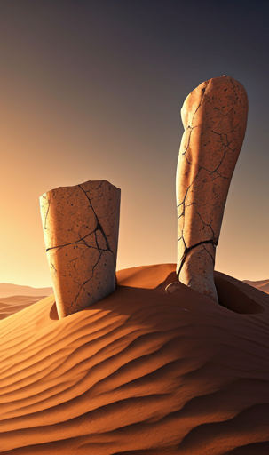
Ozymandias by Percy Shelley
I met a traveller from an antique land, Who said—“Two vast and trunkless legs of stone Stand in the desert. . . . Near them, on the sand, Half sunk a shattered visage lies, whose frown, And wrinkled lip, and sneer of cold command, Tell that its sculptor well those passions read Which yet survive, stamped on these lifeless things, The hand that mocked them, and the heart that fed; And on the pedestal, these words appear: My name is Ozymandias, King of Kings; Look on my Works, ye Mighty, and despair! Nothing beside remains. Round the decay Of that colossal Wreck, boundless and bare The lone and level sands stretch far away.”

Slide 5
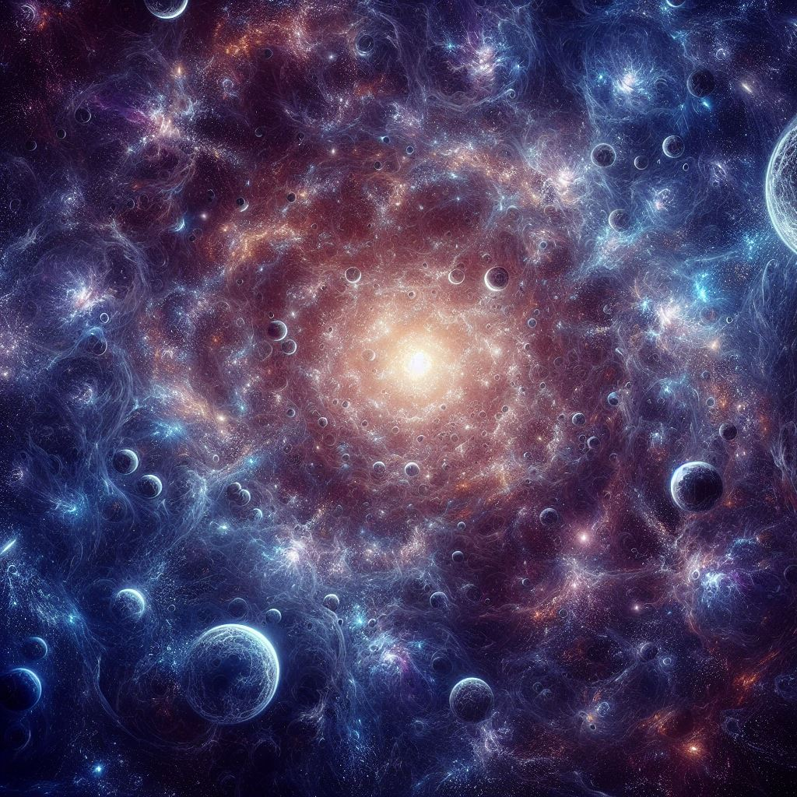
Large Scale Entropy
The heat death of the universe

Slide 6
Absurdity

Slide 7
Absurdity and Meaninglessness
We are in a sliver of something in between two eternal nothings

Slide 8
Some possible reactions to absurdity

Slide 9
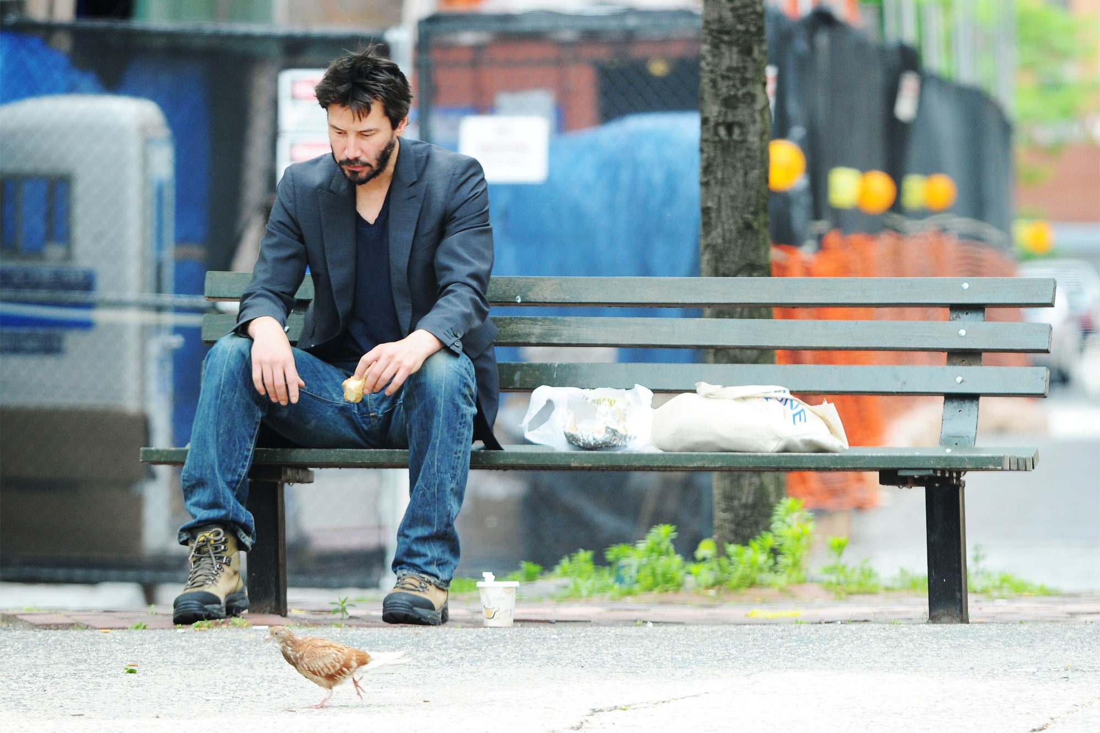
Despair

Slide 10
Distraction

Slide 11
Numbing

Slide 12
Totalist belief systems

Slide 13
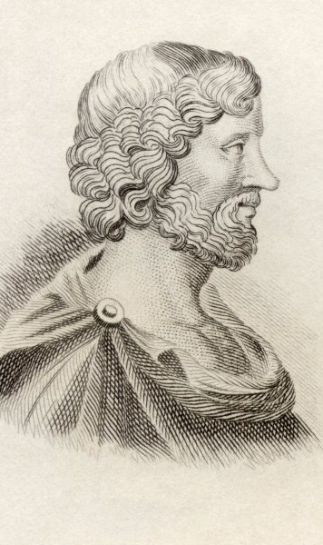
Another reaction to absurdity: Aristippus
Ancient Greek philosopher, and student of Socrates
Premise one: we are alive right now
Premise two: we will someday day
Premise three: pleasure feels good
Conclusion: we should devote all our time to seeking out the most intense pleasure possible
“The art of life lies in taking pleasures as they pass, and the keenest pleasures are not intellectual, nor are they always moral.”
Hedonism

Slide 14
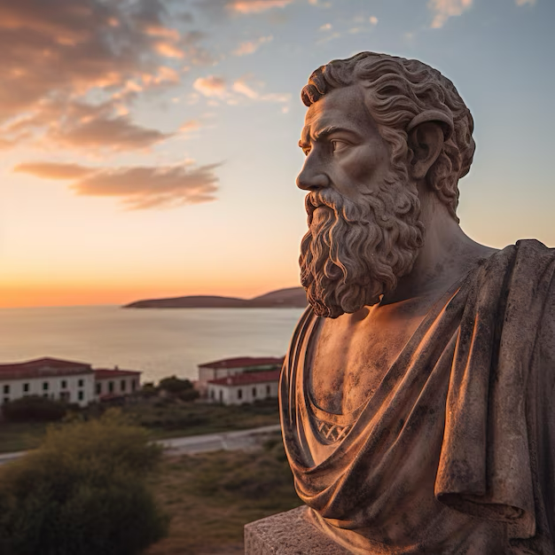
Another reaction to absurdity: Epicurus
Ancient Greek philosopher, influenced by Aristippus
Like Socrates, he was accused of being an atheist
Epicurus’ paradox:
If God wants to stop evil, but can’t, then he is not all-powerful
If he can stop evil, but doesn’t want to, then he’s not good
If he wants to stop evil, and is able to stop evil, then why is there evil?
If he is neither able nor willing to stop evil, then why worship him?
He was also accused of being a hedonist

Slide 15
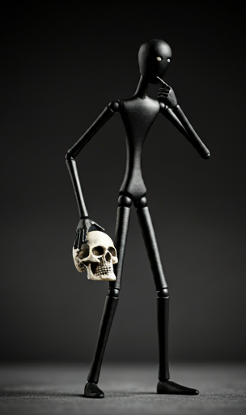
Epicurus and death
Death was not something to be afraid of
If you are afraid of death, you must not be dead yet
If you were dead, you wouldn’t be afraid of it
You have already not existed, and it didn’t bother you then

Slide 16
Epicurean Hedonism vs Aristippean Hedonism
Aristippus: get as much pleasure as you can right now, and the more intense the better. You could be dead tomorrow, and you’d feel foolish turning down an opportunity today
Epicurus: it is more important to minimize pain than to maximize immediate pleasure. Take pleasure in the simplest things, and the end result will be a happy life – a state of ataraxia (tranquility)

Slide 17
Epicureanism
Not all pleasures are natural, and not all natural pleasures are necessary
Natural: aids in our survival
Necessary: something that is required

Slide 21
What are the natural necessary pleasures, according to Epicurus?
Food
Warmth
Shelter
Friendship

