Slide 1
Unit 4
Love and Happiness, and why we are not good at them

Slide 2
Philosophical hedonists
Epicurus
“Do not spoil what you have by desiring what you have not; remember that what you now have was once among the things you only hoped for.”
Aristippus
“The art of life lies in taking pleasures as they pass, and the keenest pleasures are not intellectual, nor are they always moral.”

Slide 3
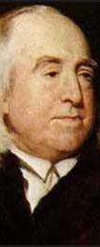
Jeremy Bentham
English philosopher
1748-1832
Founder of the philosophical system of utilitarianism
Argues that all of our decisions should be based on a kind of hedonic calculus - a mathematically-based decision system in which the greatest amount of pleasure is the desired outcome regardless of the “morality” of the action itself
Still attends meetings of the Utilitarian Society

Slide 4
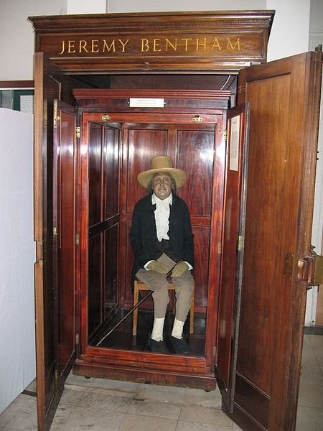
Ree

Slide 5
Bentham’s Head

Slide 6
Hedonic Calculus
Intensity
Duration
Certainty
Purity
Fecundity
Propinquity
Extent

Slide 7
The Futile Pursuit of Happiness
Dan Gilbert is a contemporary philosopher who argues that all of our major decisions are made as a result of a kind of hedonic calculus
The problem isn’t that we seek pleasure and happiness, the problem is we don’t do it correctly
Unfortunately, we are not very good at anticipating what will make us happy or sad
We have many examples of this…

Slide 8
Think of something that could happen that would make you happy for the rest of your life

Slide 9
Winning the Lottery

Slide 10
Anecdotal evidence

Slide 11
Michael Carroll won about 20 million dollars

Slide 12
Attempted suicide twice, now happier and living on $80 a week

Slide 13
William Harrell won 31 million dollars in 1997

Slide 14
Took his own life in 1999

Slide 15
William “Bud” Post Won 16 million dollars

Slide 16
$500 000 in debt in six months

Slide 17
Jack Whittaker won $314 million in 2002

Slide 18
DUI conviction, dead daughter and granddaughter

Slide 19
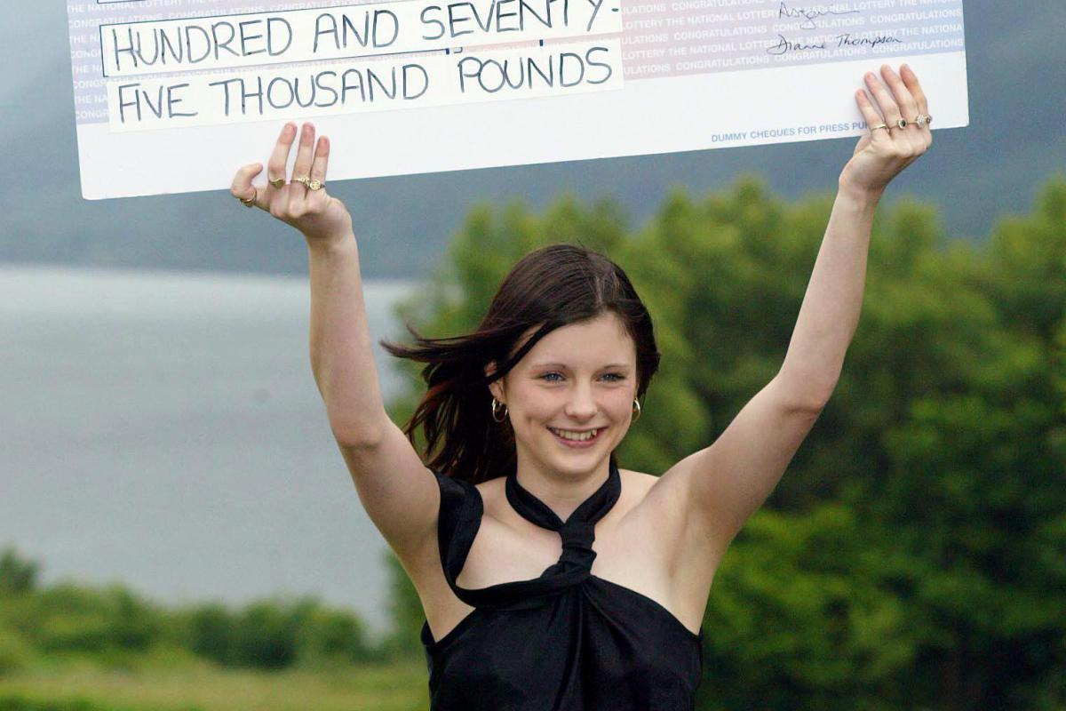
Callie Rogers won $3 million in 2003

Slide 20
Attempted suicide twice

Slide 21
Some statistical evidence
It is difficult to get good stats on lottery winners, since the population is so small
Winners of a small amount (<$150,000) were twice as likely to go bankrupt than the general population
In a larger study, 37% of families said they were less happy than they were before winning the lottery
43% of winners said there was no change in happiness after they won the lottery
68% of lottery winners still play the lottery every week

Slide 22
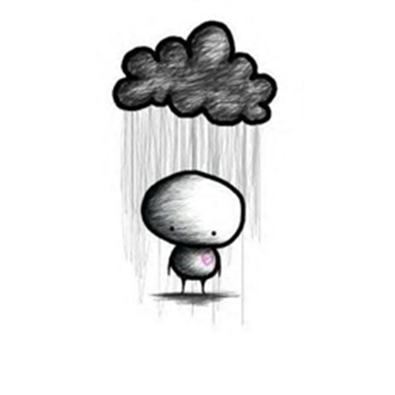
Why are we wrong about our happiness?
We tend to think that long-term nagging problems or slight improvements will affect us less than big dramatic one-time events
This is incorrect – it’s like the belief that you’ll stay drier standing in a slow rain for an hour, rather than having a glass of water thrown on you
We overestimate our emotional reactions to singular events
“Impact bias”, which leads to “miswanting”

Slide 23
The cause of impact bias: adaptation
Happiness is not a state, it’s a motivating signal
Our brain rewards us for success, but does not do so permanently
If it did, we would not continue attempting to succeed at things
We have the tendency to return to a base level of contentment, rather than stay in an elevated level of happiness or sadness

Slide 24
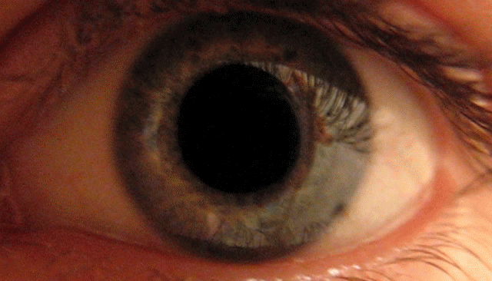
Example of a similar process
Example of a similar process: the eye adapts to different levels of illumination

Slide 25
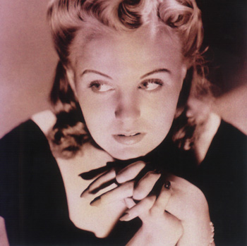
I remember when I was a very little girl, our house caught on fire.
I'll never forget the look on my father's face as he gathered me up
In his arms and raced through the burning building out to the pavement.
I stood there shivering in my pajamas and watched the whole world go up in flames.
And when it was all over I said to myself,
"Is that all there is to a fire?”
“Is that all there is?” sung by an unimpressed Peggy Lee

Slide 26
Mood adaptation
Our minds adapt to different situations and events and return us to our base state.
We don’t think about this when we anticipate how happy or sad something will make us

Slide 27
Another reason we’re terrible at predicting happiness…

Slide 28
“The Empathy Gap”
Argument by George Loewenstein, another modern happiness theorist
We think differently when we are in a “hot” state than when we are in a “cold” state
Hot states: “…anxiety, courage, fear, drug craving, sexual excitation…”
When we are in a hot state, we make decisions that we would never make otherwise
These decisions don’t tend to be excellent choices

Slide 30
Suicide Stats
According to a New England Journal of Medicine study:
24% of near-lethal suicide attempts involved less than 5 minutes of consideration
70% of near-lethal suicide attempts involved less than 1 hour of consideration
A 1978 study showed that, of 515 people who had been prevented from jumping off the Golden Gate Bridge, 94% of them had not re-attempted suicide

Slide 31
Conclusions?
We need to think more about the way we feel
We need to become better at our internal hedonic calculations
We need to overcome the initial sharpness of our immediate reactions, and look ahead to our “cool” state
If we understand better what actually makes us happy and unhappy, we can lead more fulfilling lives

